Slide 1


Interaction between bacteria and viruses :
discovering new genes involved into bacterial defense mechanisms against phages
Rémy Dugauquier
Promoters : Abel Garcia-Pino et Gipsi Lima Mendez
May 06, 2022

Slide 2
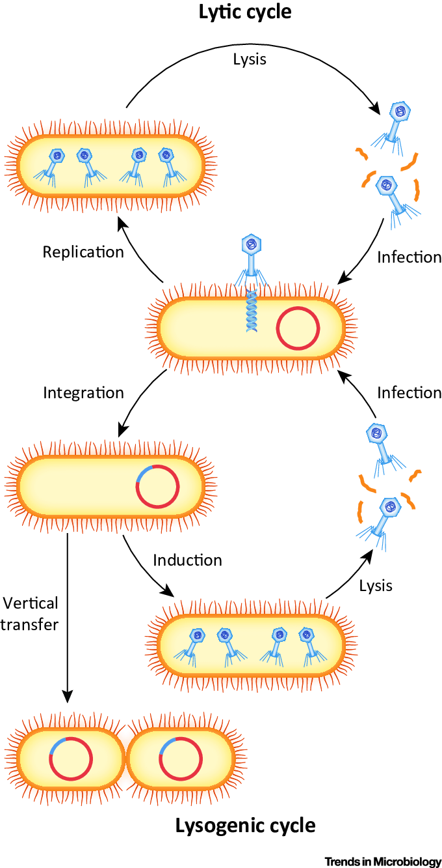
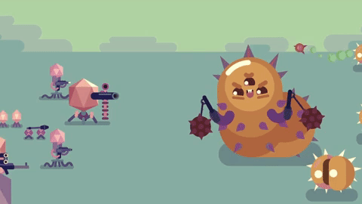
Introduction
Goal
Targeted strategy
Conclusion
And after
Classical approach
Known systems analysis
Targeted strategy : results
Bacteria and phages
Prophage
Lysogen
1
Keen.E and Dantas.G, “Close Encounters of Three Kinds : Bacteriophages, Commensal Bacteria, and Host Immunity” Trends in Microbioly, 2018.

Slide 3
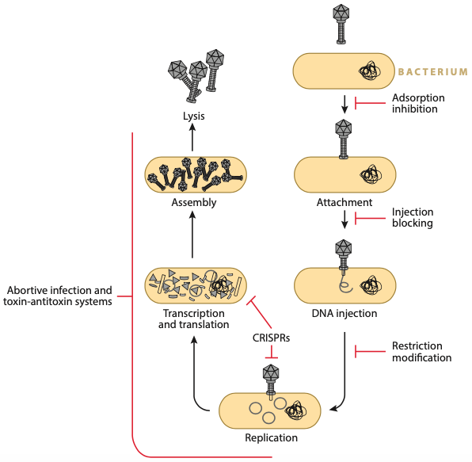
Introduction
Goal
Targeted strategy
Conclusion
And after
Classical approach
Known systems analysis
Targeted strategy : results
Bacterial defense systems against phages
Bacterium
Adsorption
inhibition
Lysis
Assembly
Attachment
Injection
blocking
Abortive infection
Transcription and translation
DNA injection
CRISPRs
Restriction
Modification
Replication
2
A. Bernheim and R. Sorek, “The pan-immune system of bacteria: antiviral defence as a community resource,” Nat. Rev. Microbiol., 2019.

Slide 4
Introduction
Goal
Targeted strategy
Conclusion
And after
Classical approach
Known systems analysis
Targeted strategy : results
Bacterial defense systems against phages
Systems targeting the beginning
of the infection cycle
Bacterium
Adsorption
inhibition
Lysis
Assembly
Attachment
Injection
blocking
Abortive infection
Transcription and translation
DNA injection
CRISPRs
Restriction
Modification
Replication
2
A. Bernheim and R. Sorek, “The pan-immune system of bacteria: antiviral defence as a community resource,” Nat. Rev. Microbiol., 2019.

Slide 5
Introduction
Goal
Targeted strategy
Conclusion
And after
Classical approach
Known systems analysis
Targeted strategy : results
Bacterial defense systems against phages
Systems targeting the beginning
of the infection cycle
Bacterium
Adsorption
inhibition
Nucleic acid degradation
systems
Lysis
Assembly
Attachment
Injection
blocking
Abortive infection
Transcription and translation
DNA injection
CRISPRs
Restriction
Modification
Replication
2
A. Bernheim and R. Sorek, “The pan-immune system of bacteria: antiviral defence as a community resource,” Nat. Rev. Microbiol., 2019.

Slide 6
Introduction
Goal
Targeted strategy
Conclusion
And after
Classical approach
Known systems analysis
Targeted strategy : results
Bacterial defense systems against phages
Systems targeting the beginning
of the infection cycle
Bacterium
Adsorption
inhibition
Nucleic acid degradation
systems
Lysis
Cell suicide system
Assembly
Attachment
Injection
blocking
Abortive infection
Transcription and translation
DNA injection
CRISPRs
Restriction
Modification
Replication
2
A. Bernheim and R. Sorek, “The pan-immune system of bacteria: antiviral defence as a community resource,” Nat. Rev. Microbiol., 2019.

Slide 7
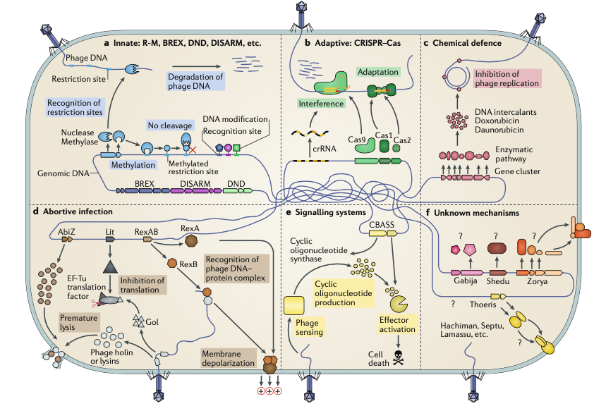
Introduction
Goal
Targeted strategy
Conclusion
And after
Classical approach
Known systems analysis
Targeted strategy : results
Bacterial defense systems against phages
Adsorption inhibition
DNA injection blocking
Restriction – Modification (RM)
CRIPSR
Abortive infection
S. Doron and R. Sorek, “Systematic discovery of antiphage defense systems in the microbial pangenome,” Nat. Microbiol., vol. 359, pp. 1–9, 2017.
3

Slide 8
Introduction
Goal
Targeted strategy
Conclusion
And after
Classical approach
Known systems analysis
Targeted strategy : results
Bacterial defense systems against phages
Adsorption inhibition
DNA injection blocking
Restriction – Modification (RM)
CRIPSR
Abortive infection
Toxin - Antitoxin
BREX
DISARM
CBASS
DND
S. Doron and R. Sorek, “Systematic discovery of antiphage defense systems in the microbial pangenome,” Nat. Microbiol., vol. 359, pp. 1–9, 2017.
3

Slide 9
Introduction
Goal
Targeted strategy
Conclusion
And after
Classical approach
Known systems analysis
Targeted strategy : results
Bacterial defense systems against phages
Zorya
Gajiba
Shedu
Septu
Druantia
Thoeris
Wadjet
Hachiman
Lamassu
Kiwa
Adsorption inhibition
DNA injection blocking
Restriction – Modification (RM)
CRIPSR
Abortive infection
Toxin - Antitoxin
BREX
DISARM
CBASS
DND
S. Doron and R. Sorek, “Systematic discovery of antiphage defense systems in the microbial pangenome,” Nat. Microbiol., vol. 359, pp. 1–9, 2017.
3

Slide 10
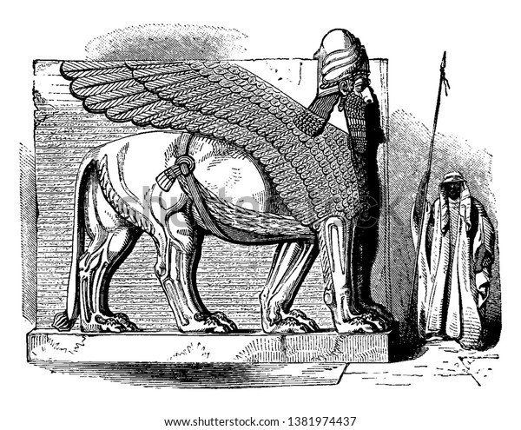

Introduction
Goal
Targeted strategy
Conclusion
And after
Classical approach
Known systems analysis
Targeted strategy : results
Bacterial defense systems against phages
Zorya
Gajiba
Shedu
Septu
Druantia
Thoeris
Wadjet
Hachiman
Lamassu
Kiwa
Adsorption inhibition
DNA injection blocking
Restriction – Modification (RM)
CRIPSR
Abortive infection
Toxin - Antitoxin
BREX
DISARM
CBASS
DND
S. Doron and R. Sorek, “Systematic discovery of antiphage defense systems in the microbial pangenome,” Nat. Microbiol., vol. 359, pp. 1–9, 2017.
3

Slide 11
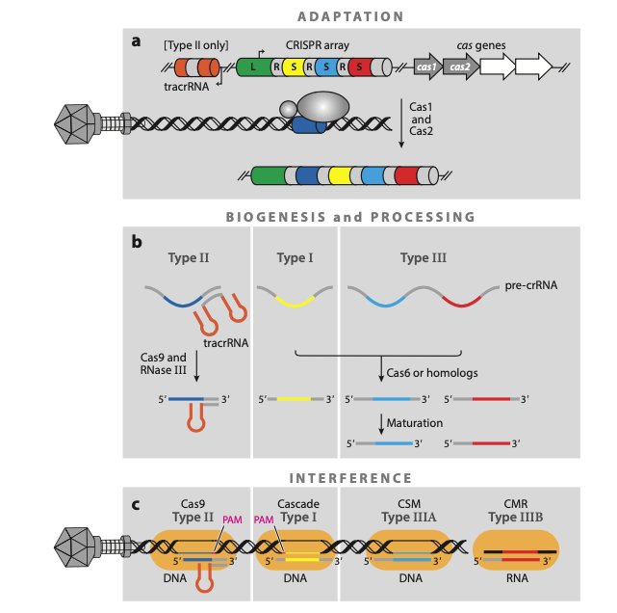
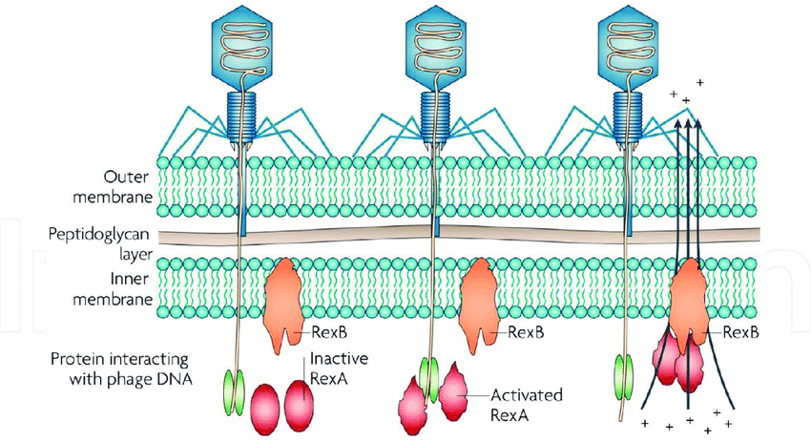
Introduction
Goal
Targeted strategy
Conclusion
And after
Classical approach
Known systems analysis
Targeted strategy : results
Bacterial defense systems against phages
→ Abortive infection
→ CRISPR-CAS

Slide 12
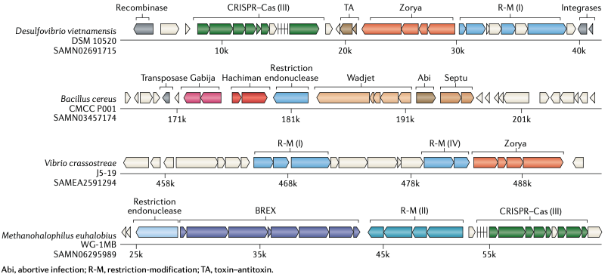
Introduction
Goal
Targeted strategy
Conclusion
And after
Classical approach
Known systems analysis
Targeted strategy : results
Bacterial defense islands
4
A. Bernheim and R. Sorek, “The pan-immune system of bacteria: antiviral defence as a community resource,” Nat. Rev. Microbiol., 2019.

Slide 13
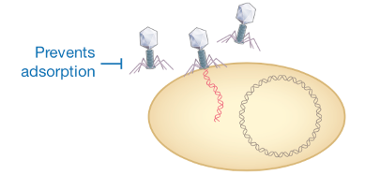
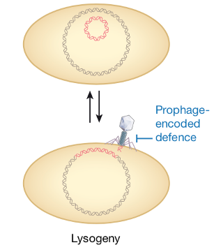
Introduction
Goal
Targeted strategy
Conclusion
And after
Classical approach
Known systems analysis
Targeted strategy : results
Lysogenic conversion genes
Lysogeny
5
Hampton et al., Nature 2020

Slide 14
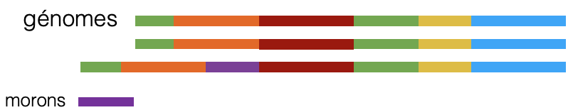
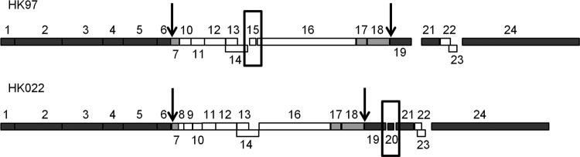
Introduction
Goal
Targeted strategy
Conclusion
And after
Classical approach
Known systems analysis
Targeted strategy : results
Lysogenic conversion genes
genomes
morons
Genes not conserved in phage genomes that lack
phage function and may act as fitness factors
Genomic map of the morphogenetic regions of phages HK97 and HK022. The morons gp15 and gp20 are framed
Lysogeny
Lysogenic conversion = expression of bacteriophage genes
in the prophage
Hampton et al., Nature 2020

Slide 15
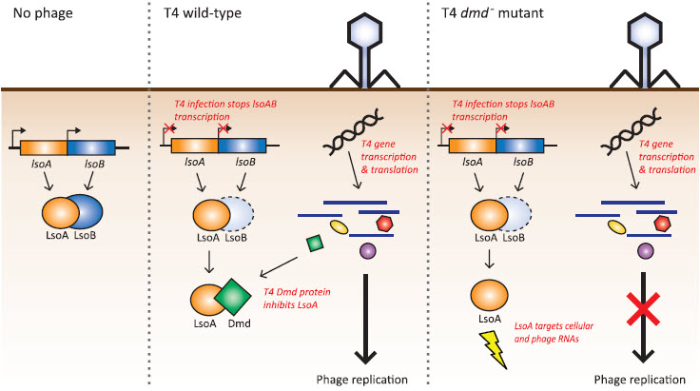
Introduction
Goal
Targeted strategy
Conclusion
And after
Classical approach
Known systems analysis
Targeted strategy : results
Phage strategies to counteract defence systems
Hijacked phage encoded versions of bacterial defense mechanism
6
Short.L.F et al. Mol Microbiol 2012

Slide 16
Introduction
Goal
Targeted strategy
Conclusion
And after
Classical approach
Known systems analysis
Targeted strategy : results
Phage strategies to counteract defence systems
Hijacked phage encoded versions of bacterial defense mechanism
6
Short.L.F et al. Mol Microbiol 2012

Slide 17
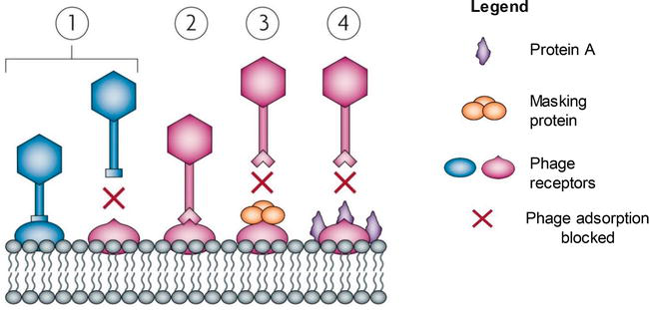
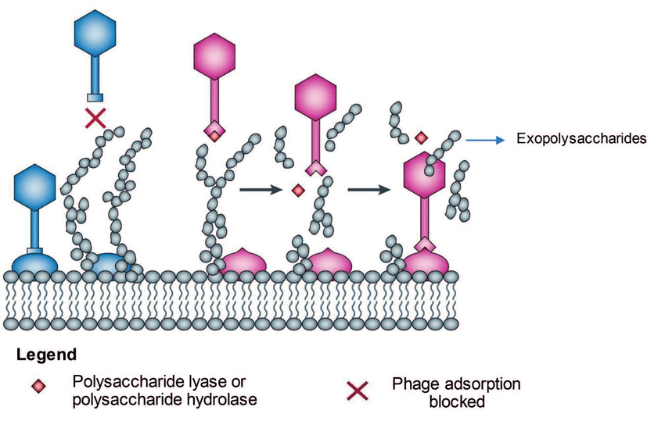
Introduction
Goal
Targeted strategy
Conclusion
And after
Classical approach
Known systems analysis
Targeted strategy : results
Phage strategies to counteract defence systems
Modification of the phage
https://www.researchgate.net/figure/Bacterial-strategies-to-inhibit-phage-adsorption-and-phage-strategies-to-access-host_fig1_337215140

Slide 18
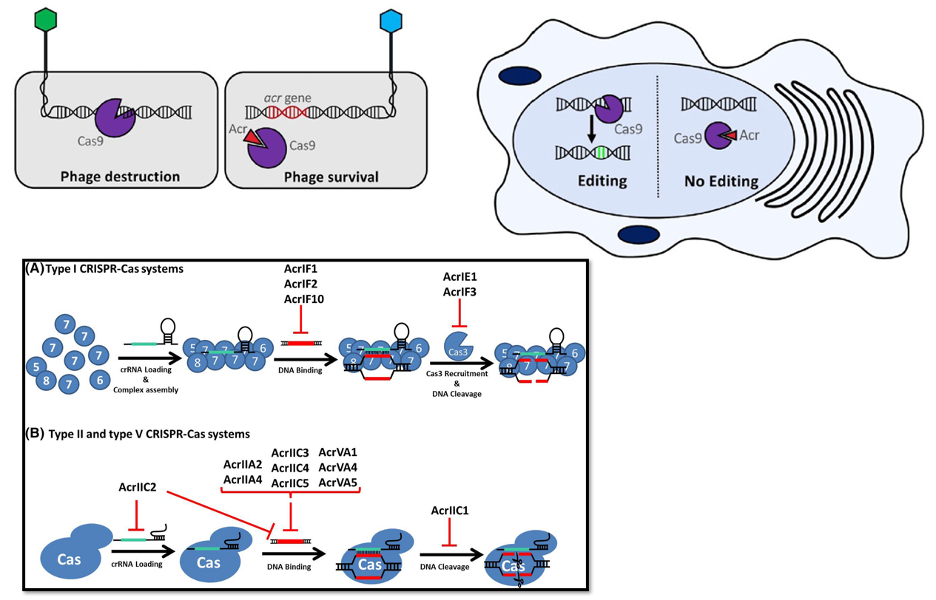
Introduction
Goal
Targeted strategy
Conclusion
And after
Classical approach
Known systems analysis
Targeted strategy : results
Phage strategies to counteract defence systems

Slide 19
Introduction
Goal
Targeted strategy
Conclusion
And after
Classical approach
Known systems analysis
Targeted strategy : results
Goal
Discovery of bacterial defense systems against phages
Two main parts :
- Bioinformatics : prediction of new defense systems
- Experimental : validation of predicted systems
7

Slide 20
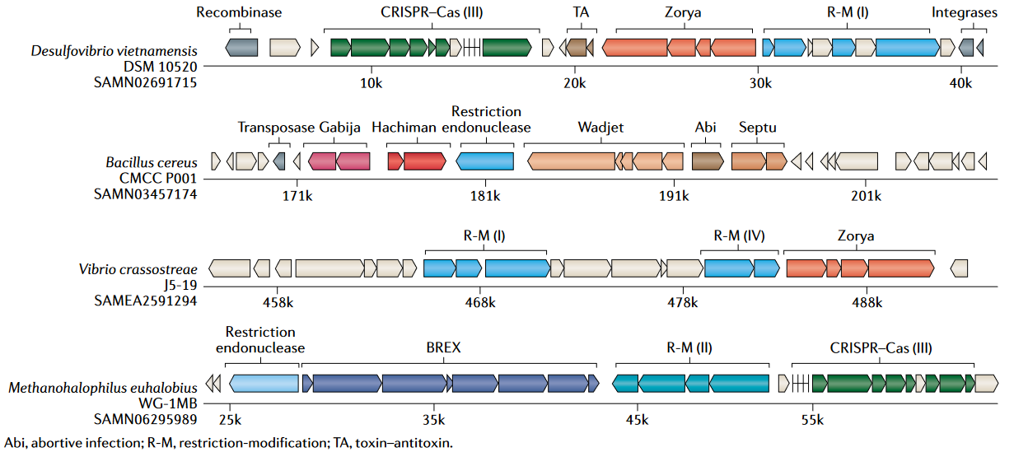
Introduction
Goal
Targeted strategy
Conclusion
And after
Classical approach
Known systems analysis
Targeted strategy : results
→ Search for defense mechanisms – classical approach
A. Bernheim and R. Sorek, Nat. Rev. Microbiol., 2019.
8

Slide 21
Introduction
Goal
Targeted strategy
Conclusion
And after
Classical approach
Known systems analysis
Targeted strategy : results
→ Search for defense mechanisms – classical approach
A. Bernheim and R. Sorek, Nat. Rev. Microbiol., 2019.
8

Slide 22
Introduction
Goal
Targeted strategy
Conclusion
And after
Classical approach
Known systems analysis
Targeted strategy : results
→ Search for defense mechanisms – classical approach
A. Bernheim and R. Sorek, Nat. Rev. Microbiol., 2019.
RM
Abi
Genome 1
CRISPR
TA
Genome 2
Genome 3
Genome 4
Zorya
RM
Genome 5
Genome n
.
.
.
.
.
.
Known systems identification
Defense system candidate
Science, S.Doron, R.Sorek et al, “Systematic discovery of antiphage defense systems in the microbial pangenome”, 2018
Science, L.Gao, E.Koonin et al, “Diverse enzymatic activities mediate antiviral immunity in prokaryotes”, 2020
8

Slide 23
Introduction
Goal
Targeted strategy
Conclusion
And after
Classical approach
Known systems analysis
Targeted strategy : results
→ Search for defense mechanisms – classical approach
A. Bernheim and R. Sorek, Nat. Rev. Microbiol., 2019.
Two new strategies:
Horizontal gene transfer → untargeted strategy
Mobile genetic elements → targeted strategy
9

Slide 24
Introduction
Goal
Targeted strategy
Conclusion
And after
Classical approach
Known systems analysis
Targeted strategy : results
→ Search for defense mechanisms – classical approach
A. Bernheim and R. Sorek, Nat. Rev. Microbiol., 2019.
Two new strategies:
Horizontal gene transfer → untargeted strategy
Mobile genetic elements → targeted strategy
9

Slide 25
Introduction
Goal
Targeted strategy
Conclusion
And after
Classical approach
Known systems analysis
Targeted strategy : results
→ Search for defense mechanisms – classical approach
A. Bernheim and R. Sorek, Nat. Rev. Microbiol., 2019.
Two new strategies:
Horizontal gene transfer → untargeted strategy
Mobile genetic elements → targeted strategy
9

Slide 26
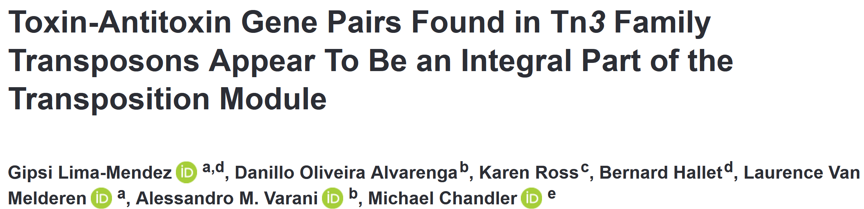
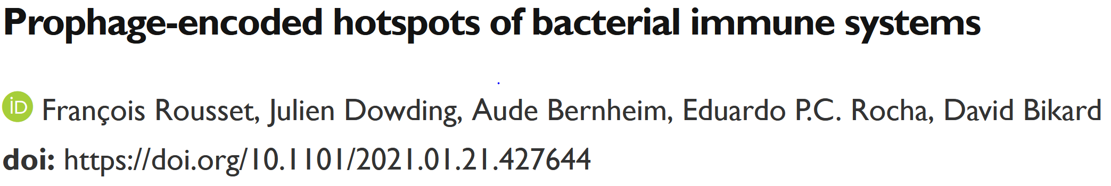
Introduction
Goal
Targeted strategy
Conclusion
And after
Classical approach
Known systems analysis
Targeted strategy : results
→ Targeted strategy : neighborhood of mobile genetic elements
Transposon Tn3
IRL
tnpR
tnpA
IRR
TA
IRL
tnpl
tnpA
IRR
TA
IRL
tnpT
tnpS
tnpA
IRR
TA
Prophages P4
P4 genes
Integrase
RM
Shedu
Gabija
10

Slide 27
Introduction
Goal
Targeted strategy
Conclusion
And after
Classical approach
Known systems analysis
Targeted strategy : results
→ Targeted strategy : neighborhood of mobile genetic elements
Transposon Tn3
IRL
tnpR
tnpA
IRR
TA
IRL
tnpl
tnpA
IRR
TA
IRL
tnpT
tnpS
tnpA
IRR
TA
Prophages P4
P4 genes
Integrase
Candidate defense system
RM
MGE gene
Shedu
Prophage
Gabija
10

Slide 28
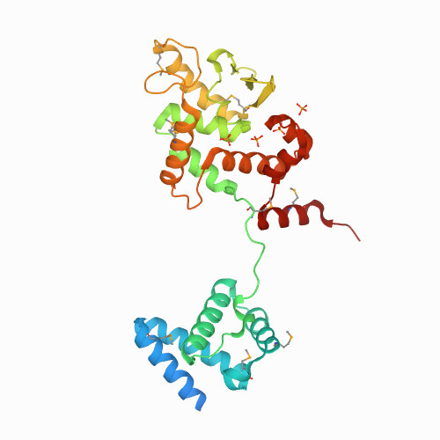
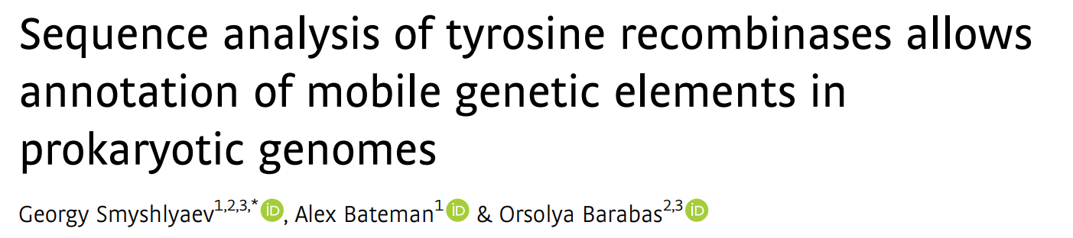
Introduction
Goal
Targeted strategy
Conclusion
And after
Classical approach
Known systems analysis
Targeted strategy : results
→ Targeted strategy : neighborhood of mobile genetic elements
Candidate defense system
MGE gene
Prophage
« Tyrosine recombinase (YR) drive MGE mobilization and could provide markers for MGE detection » G.Smyshlyaev et al.
11

Slide 29
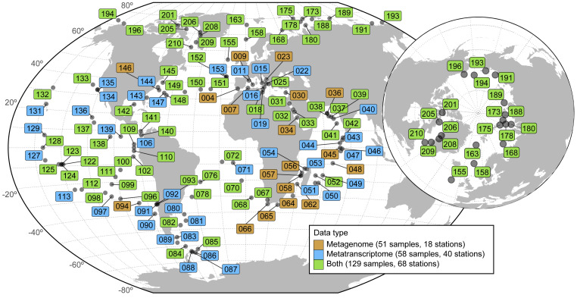


Introduction
Goal
Targeted strategy
Conclusion
And after
Classical approach
Known systems analysis
Targeted strategy : results
Tara Oceans Catalog
370 meta-genomes
187 meta-transcriptomes
OG/KO/GC functional profiles for prokaryotes
Taxonomic profiles (from domain to species)
47 millions genes
Environnemental data (37 variables)
12
Salazar.G et al, Cell, 2019 – Sunagawa, Coelho, Chaffron, et al., Science 2015

Slide 30
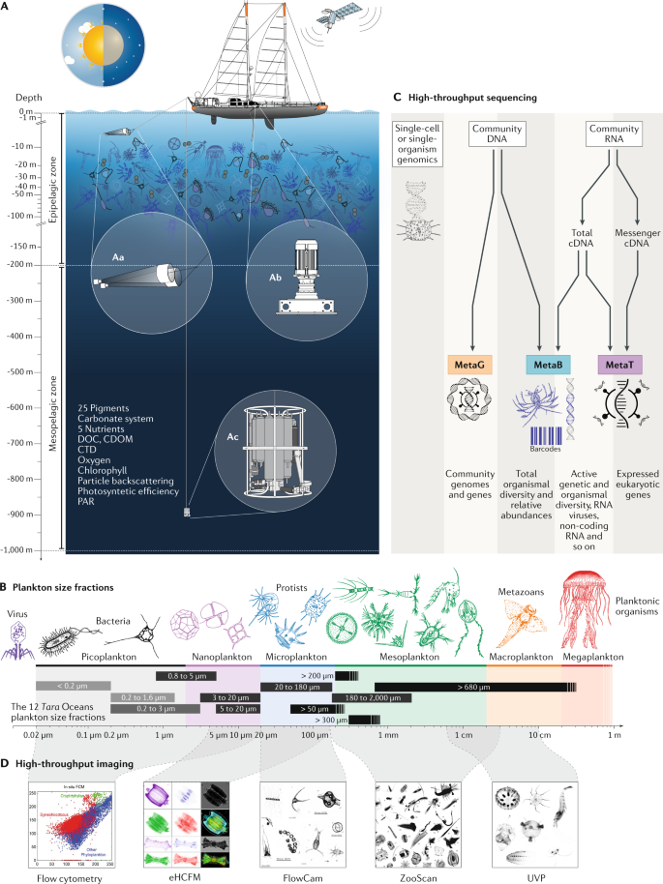
Introduction
Goal
Targeted strategy
Conclusion
And after
Classical approach
Known systems analysis
Targeted strategy : results

Slide 31
Introduction
Goal
Targeted strategy
Conclusion
And after
Classical approach
Known systems analysis
Targeted strategy : results
→ Relevance of TARA Oceans data?
13

Slide 32

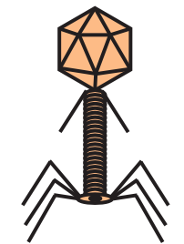
Introduction
Goal
Targeted strategy
Conclusion
And after
Classical approach
Known systems analysis
Targeted strategy : results
→ Relevance of TARA Oceans data?
?
13

Slide 33
Introduction
Goal
Targeted strategy
Conclusion
And after
Classical approach
Known systems analysis
Targeted strategy : results
→ Relevance of TARA Oceans data?
?
Creation of a known defense systems database
Search for known systems in TARA date
13

Slide 34
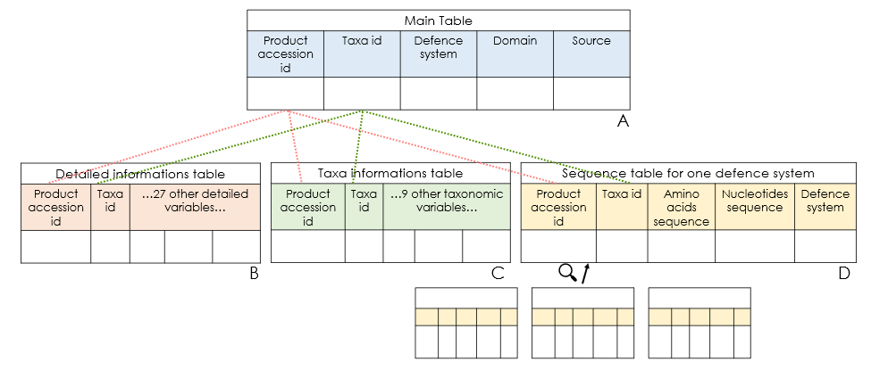
Introduction
Goal
Targeted strategy
Conclusion
And after
Classical approach
Known systems analysis
Targeted strategy : results
→ Creation of a known defense systems database
1. Identify known systems in TARA
2. Evaluation of tools
3. Store mechanisms discovered
14

Slide 35
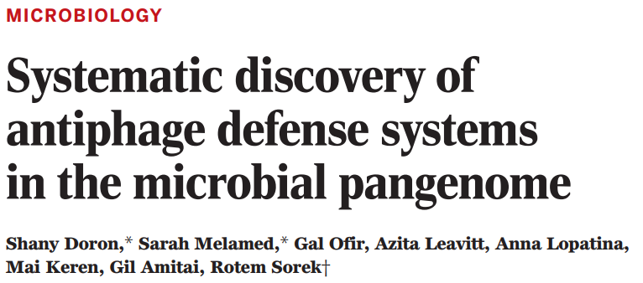
Introduction
Goal
Targeted strategy
Conclusion
And after
Classical approach
Known systems analysis
Targeted strategy : results
→ Creation of a known defense systems database
Number of defence systems | 18
Number of distinct instances (product accession) | 4.989.722
Number of distinct organisms (taxa id) | 36.435
Number of distinct metagenomes | 523
Number of distinct protein sequences | 4.989.722
Number of distinct DNA sequences | 4.989.722
Number of distinct variables for all the library | 37
Number of defence systems | 18
→ 2018
15

Slide 36
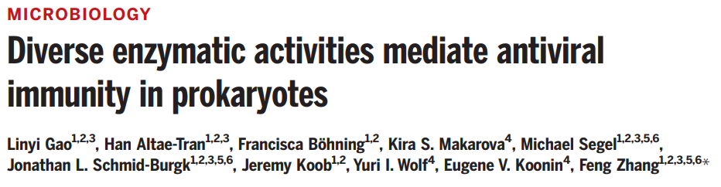
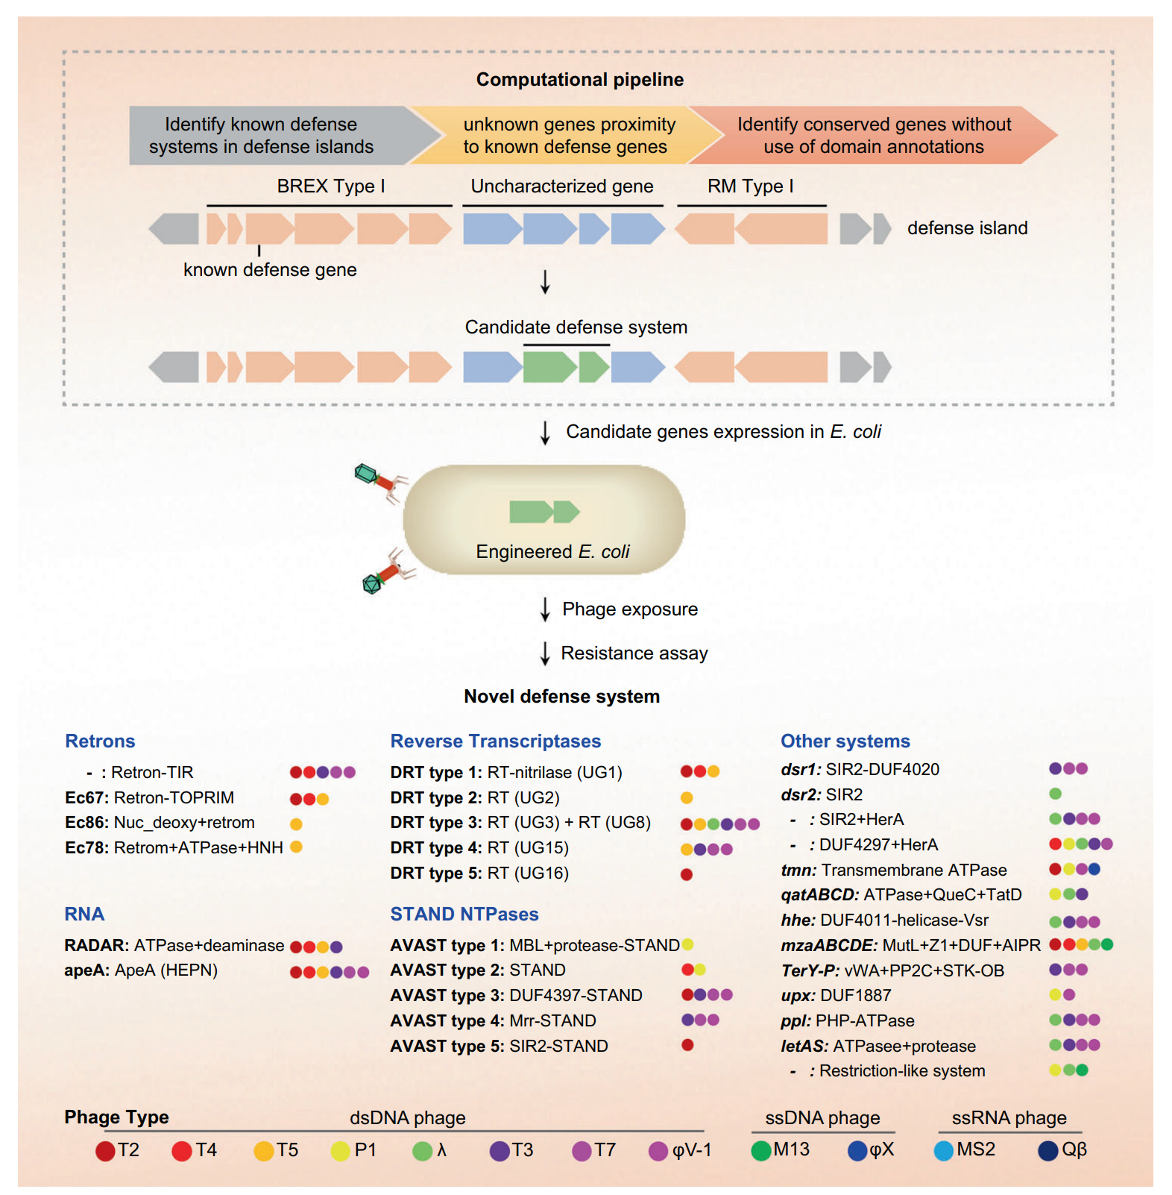
Introduction
Goal
Targeted strategy
Conclusion
And after
Classical approach
Known systems analysis
Targeted strategy : results
→ Creation of a known defense systems database
→ 2018
→ 2020
16

Slide 37
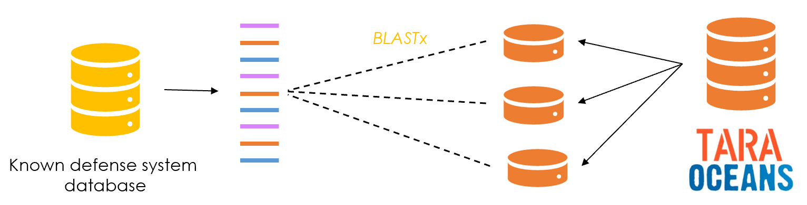
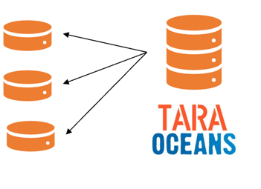


Introduction
Goal
Targeted strategy
Conclusion
And after
Classical approach
Known systems analysis
Targeted strategy : results
→ Search for known systems in TARA data
PADLOC database
My known defence database : 18 systems, mainly from PADS and discovered by Doron and Sorek,2018. I used BlastP to detect all these systems in TARA data.
PADLOC is a software tool for identifying defence systems, I obtained the HMM file with their system and I detected these system in TARA with Hmmsearch. This database contains « old » systems and also the new ones discovered in 2020 by Gao et al
17

Slide 38
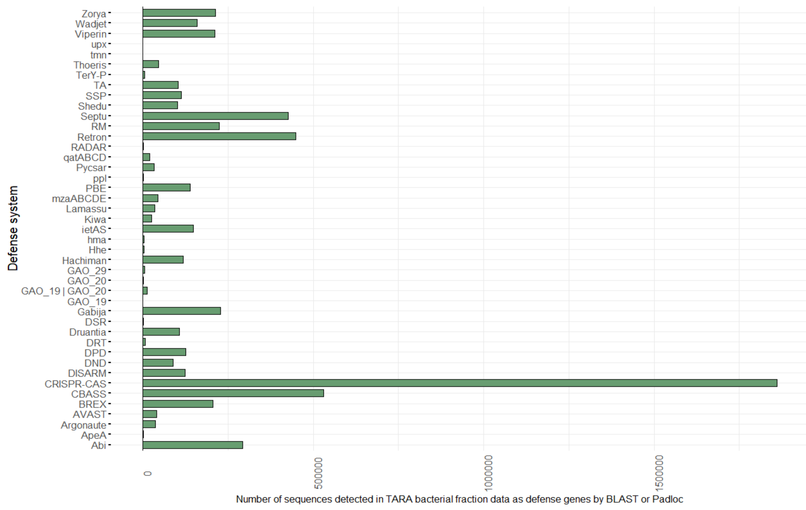
Introduction
Goal
Targeted strategy
Conclusion
And after
Classical approach
Known systems analysis
Targeted strategy : results
→ Search for known systems in TARA data
Number of TARA genes | Number of defense genes BLAST & Padloc | Number of defense genes BLAST | Number of defense genes Padloc
153.940.861 | 11.297.931 | 1.383.829 | 10.227.402
18

Slide 39
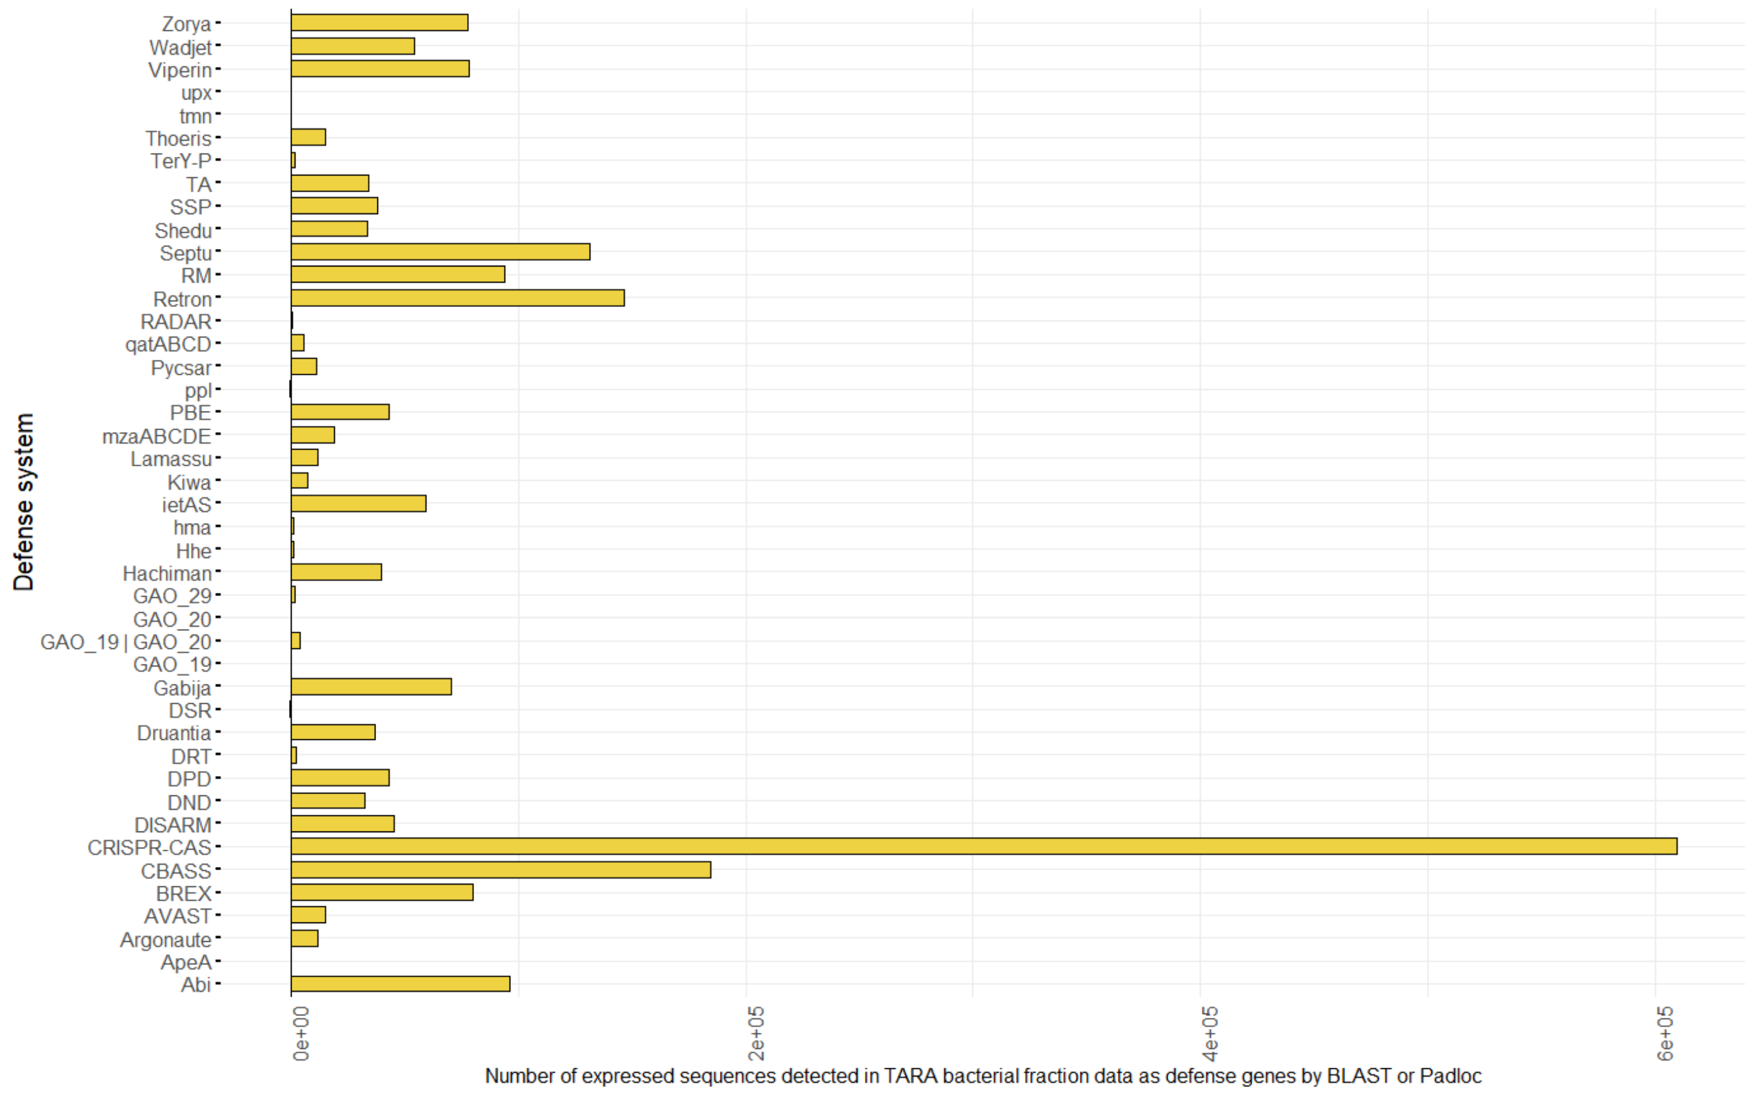
Introduction
Goal
Targeted strategy
Conclusion
And after
Classical approach
Known systems analysis
Targeted strategy : results
→ Search for known systems in TARA data
18

Slide 40
Introduction
Goal
Targeted strategy
Conclusion
And after
Classical approach
Known systems analysis
Targeted strategy : results
→ Targeted strategy – First step
TARA Oceans
86 M contigs (154 M genes)
genes
contigs
Filtration des contigs >3 gènes
51.527.577 gènes & 11.377.801 contigs
Identification des prophages dans les contigs de TARA avec Virsorter2
726.295 contigs & 3.809.940 gènes
Détection des séquences de Tyrosine Recombinase avec HMMER
99.860 sequences
Extraction des gènes exprimés dans les prophages
539.232 gènes
Prophage contenant un gène de Tyrosine Recombinase
Extraction de tout les gènes exprimés dans un prophage contenant une Tyrosine Recombinase
3667 gènes
Détection des familles protéiques des gènes avec HMMER et la base de données PFAM
Conservation de l’ordre des gènes prédits dans d’autres (meta)-génomes
Système de défense candidat
TR
PFAM x
PFAM y
Prophage
20

Slide 41
Introduction
Goal
Targeted strategy
Conclusion
And after
Classical approach
Known systems analysis
Targeted strategy : results
→ Targeted strategy – First step
TARA Oceans
86 M contigs (154 M genes)
genes
contigs
Filtering contigs >3 genes
11 M contigs (52 M genes)
Identification des prophages dans les contigs de TARA avec Virsorter2
726.295 contigs & 3.809.940 gènes
Détection des séquences de Tyrosine Recombinase avec HMMER
99.860 sequences
Extraction des gènes exprimés dans les prophages
539.232 gènes
Prophage contenant un gène de Tyrosine Recombinase
Extraction de tout les gènes exprimés dans un prophage contenant une Tyrosine Recombinase
3667 gènes
Détection des familles protéiques des gènes avec HMMER et la base de données PFAM
Conservation de l’ordre des gènes prédits dans d’autres (meta)-génomes
Système de défense candidat
TR
PFAM x
PFAM y
Prophage
20

Slide 42
Introduction
Goal
Targeted strategy
Conclusion
And after
Classical approach
Known systems analysis
Targeted strategy : results
→ Targeted strategy – First step
TARA Oceans
86 M contigs (154 M genes)
Filtering contigs >3 genes
11 M contigs (52 M genes)
Identification of prophages in contigs
0,7 M contigs (3.8 M genes)
Détection des séquences de Tyrosine Recombinase avec HMMER
99.860 sequences
Extraction des gènes exprimés dans les prophages
539.232 gènes
Prophage contenant un gène de Tyrosine Recombinase
Extraction de tout les gènes exprimés dans un prophage contenant une Tyrosine Recombinase
3667 gènes
Détection des familles protéiques des gènes avec HMMER et la base de données PFAM
Prophages
Conservation de l’ordre des gènes prédits dans d’autres (meta)-génomes
Système de défense candidat
TR
PFAM x
PFAM y
Prophage
20

Slide 43
Introduction
Goal
Targeted strategy
Conclusion
And after
Classical approach
Known systems analysis
Targeted strategy : results
→ Targeted strategy – First step
TARA Oceans
86 M contigs (154 M genes)
Filtering contigs >3 genes
11 M contigs (52 M genes)
Identification of prophages in contigs
0,7 M contigs (3.8 M genes)
Détection des séquences de Tyrosine Recombinase avec HMMER
99.860 sequences
Extraction des gènes exprimés dans les prophages
539.232 gènes
Prophage contenant un gène de Tyrosine Recombinase
Among the 3.8 M genes in prophage :
- 184.103 DUF
- 1.032.198 unknown genes
*analyzed with Hmmsearch vs PFAM-A
→ 32% of genes in prophage are not identified in PFAM-A
Extraction de tout les gènes exprimés dans un prophage contenant une Tyrosine Recombinase
3667 gènes
Détection des familles protéiques des gènes avec HMMER et la base de données PFAM
Prophages
Conservation de l’ordre des gènes prédits dans d’autres (meta)-génomes
Système de défense candidat
TR
PFAM x
PFAM y
Prophage
20

Slide 44
Introduction
Goal
Targeted strategy
Conclusion
And after
Classical approach
Known systems analysis
Targeted strategy : results
→ Targeted strategy – First step
TARA Oceans
86 M contigs (154 M genes)
Filtering contigs >3 genes
11 M contigs (52 M genes)
Identification of prophages in contigs
0,7 M contigs (3.8 M genes)
Détection des séquences de Tyrosine Recombinase avec HMMER
99.860 sequences
Extraction des gènes exprimés dans les prophages
539.232 gènes
Prophage contenant un gène de Tyrosine Recombinase
Among the 3.8 M genes in prophage :
- 184.103 DUF
- 1.032.198 unknown genes
*analyzed with Hmmsearch vs PFAM-A
→ 32% of genes in prophage are not identified in PFAM-A
- 32.982 known defence genes of my database
- 158.581 known defence genes from padloc and Koonin new system
→ 4% of genes in prophages are defence system genes
Extraction de tout les gènes exprimés dans un prophage contenant une Tyrosine Recombinase
3667 gènes
Détection des familles protéiques des gènes avec HMMER et la base de données PFAM
Prophages
Conservation de l’ordre des gènes prédits dans d’autres (meta)-génomes
Système de défense candidat
TR
PFAM x
PFAM y
Prophage
20

Slide 45
Introduction
Goal
Targeted strategy
Conclusion
And after
Classical approach
Known systems analysis
Targeted strategy : results
→ Targeted strategy – First step
TARA Oceans
86 M contigs (154 M genes)
Filtering contigs >3 genes
11 M contigs (52 M genes)
Identification of prophages in contigs
0,7 M contigs (3.8 M genes)
Détection des séquences de Tyrosine Recombinase avec HMMER
99.860 sequences
Expressed genes in prophages
0.5 M genes
Extraction de tout les gènes exprimés dans un prophage contenant une Tyrosine Recombinase
3667 gènes
Détection des familles protéiques des gènes avec HMMER et la base de données PFAM
Prophages
Expressed genes
Conservation de l’ordre des gènes prédits dans d’autres (meta)-génomes
Système de défense candidat
TR
PFAM x
PFAM y
Prophage
22

Slide 46
Introduction
Goal
Targeted strategy
Conclusion
And after
Classical approach
Known systems analysis
Targeted strategy : results
→ Targeted strategy – First step
TARA Oceans
86 M contigs (154 M genes)
Filtering contigs >3 genes
11 M contigs (52 M genes)
Identification of prophages in contigs
0,7 M contigs (3.8 M genes)
Tyrosine recombinase detection
100.000 sequences
Expressed genes in prophages
0.5 M genes
Extraction de tout les gènes exprimés dans un prophage contenant une Tyrosine Recombinase
3667 gènes
Détection des familles protéiques des gènes avec HMMER et la base de données PFAM
Prophages
Expressed genes
Conservation de l’ordre des gènes prédits dans d’autres (meta)-génomes
Tyrosine
recombinase
Système de défense candidat
PFAM y
22

Slide 47
Introduction
Goal
Targeted strategy
Conclusion
And after
Classical approach
Known systems analysis
Targeted strategy : results
→ Targeted strategy – First step
TARA Oceans
86 M contigs (154 M genes)
Filtering contigs >3 genes
11 M contigs (52 M genes)
Identification of prophages in contigs
0,7 M contigs (3.8 M genes)
Tyrosine recombinase detection
100.000 sequences
Expressed genes in prophages
0.5 M genes
Prophage containing a Tyrosine recombinase gene
Expressed genes
prophage
Tyrosine
recombinase
Expressed genes in a prophage containing a Tyrosine recombinase
1055 contigs (3667 genes)
Détection des familles protéiques des gènes avec HMMER et la base de données PFAM
Conservation de l’ordre des gènes prédits dans d’autres (meta)-génomes
Système de défense candidat
TR
PFAM x
PFAM y
Prophage
23

Slide 48
Introduction
Goal
Targeted strategy
Conclusion
And after
Classical approach
Known systems analysis
Targeted strategy : results
→ Targeted strategy – First step
TARA Oceans
86 M contigs (154 M genes)
Filtering contigs >3 genes
11 M contigs (52 M genes)
Identification of prophages in contigs
0,7 M contigs (3.8 M genes)
Tyrosine recombinase detection
100.000 sequences
Expressed genes in prophages
0.5 M genes
Prophage containing a Tyrosine recombinase gene
Expressed genes in a prophage containing a Tyrosine recombinase
1055 contigs (3667 genes)
PFAM annotations
1814 unknown domains (in 715 contigs)
Defense system candidate
TR
PFAM x
PFAM y
Prophage
24

Slide 49
Introduction
Goal
Targeted strategy
Conclusion
And after
Classical approach
Known systems analysis
Targeted strategy : results
→ Targeted strategy – First step
Expressed genes in a prophage containing a Tyrosine recombinase
1055 contigs (3667 genes)
PFAM annotations
1814 unknown domains (in 715 contigs)
25

Slide 50
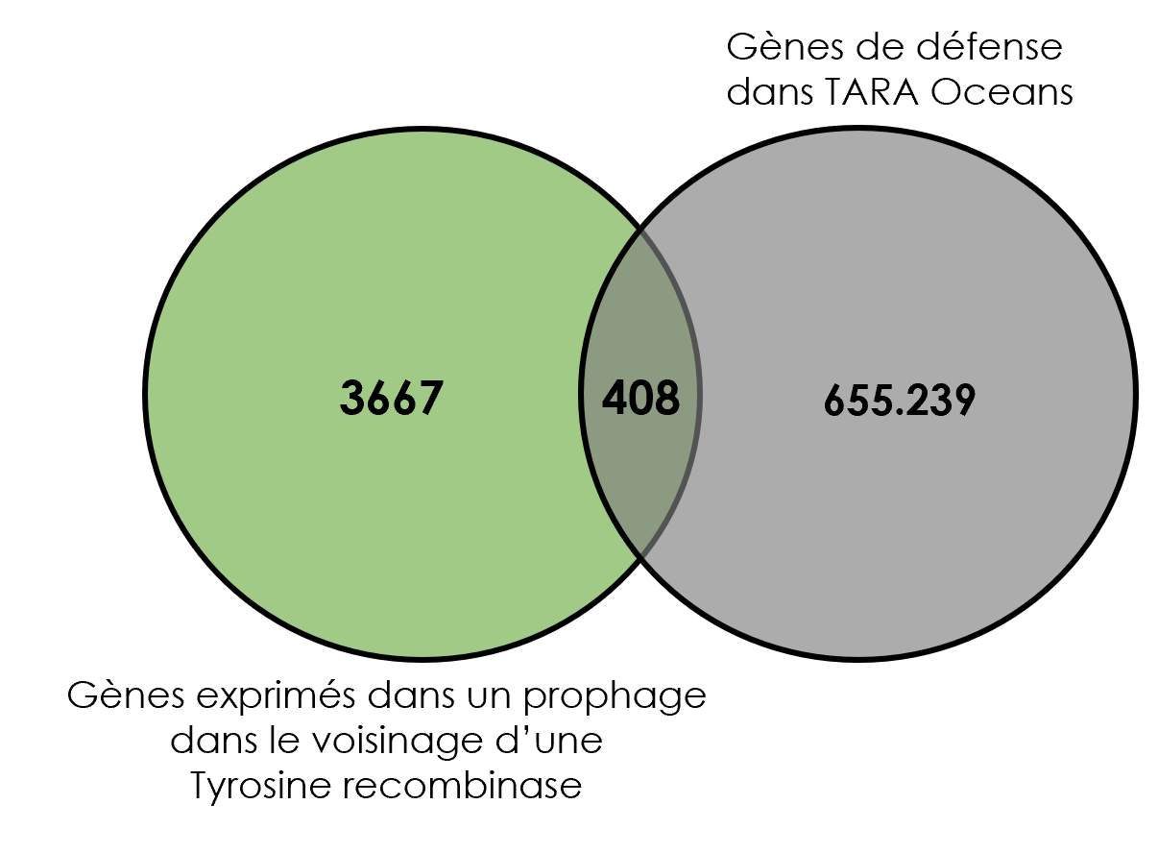
Introduction
Goal
Targeted strategy
Conclusion
And after
Classical approach
Known systems analysis
Targeted strategy : results
→ Targeted strategy – First step
Expressed genes in a prophage containing a Tyrosine recombinase
1055 contigs (3667 genes)
PFAM annotations
1814 unknown domains (in 715 contigs)
Stratégie ciblée : 18 systèmes de défense de ma base
de données
Science, S.Doron, R.Sorek et al, “Systematic discovery of antiphage defense systems in the microbial pangenome”, 2018
25

Slide 51

Introduction
Goal
Targeted strategy
Conclusion
And after
Classical approach
Known systems analysis
Targeted strategy : results
→ Targeted strategy – First step
Expressed genes in a prophage containing a Tyrosine recombinase
1055 contigs (3667 genes)
PFAM annotations
1814 unknown domains (in 715 contigs)
Stratégie ciblée : 18 systèmes de défense de ma base
de données
Stratégie ciblée : 19 systèmes de défense (Koonin et.al 2020)
Profil HMM
3667 gènes candidats
331 gènes récemment découverts
Science, S.Doron, R.Sorek et al, “Systematic discovery of antiphage defense systems in the microbial pangenome”, 2018
Science, L.Gao, E.Koonin et al, “Diverse enzymatic activities mediate antiviral immunity in prokaryotes”, 2020
25

Slide 52
Introduction
Goal
Targeted strategy
Conclusion
And after
Classical approach
Known systems analysis
Targeted strategy : results
→ Targeted strategy – Second step
Targeted strategy – First step
Defense system candidate
TR
715 contigs containing 1814 candidates genes
PFAM x
PFAM y
Prophage
26

Slide 53
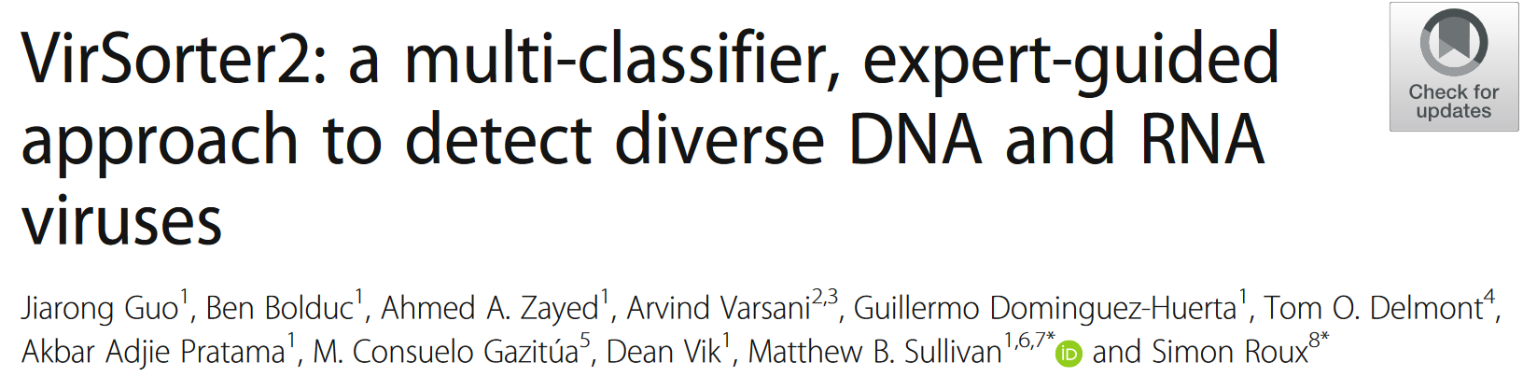
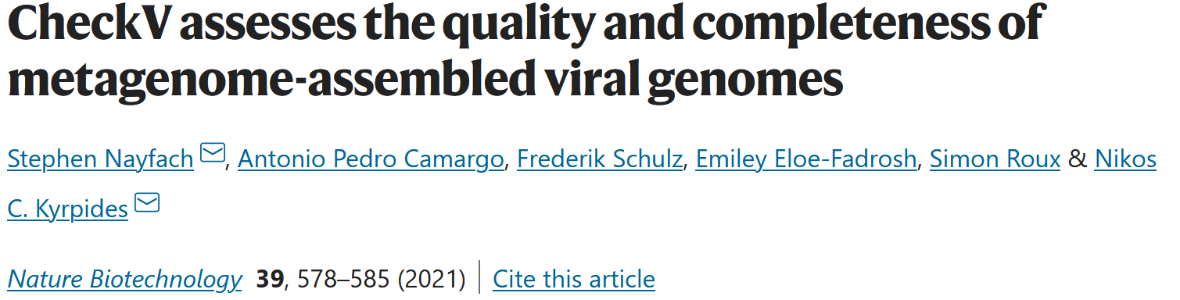
Introduction
Goal
Targeted strategy
Conclusion
And after
Classical approach
Known systems analysis
Targeted strategy : results
→ Targeted strategy – Second step
Targeted strategy – First step
Defense system candidate
TR
715 contigs containing 1814 candidates genes
PFAM x
PFAM y
Prophage
Selection of the best prophages
- Virsorter2
- PHROG and MMSEQ2
- PHASTER
26

Slide 54

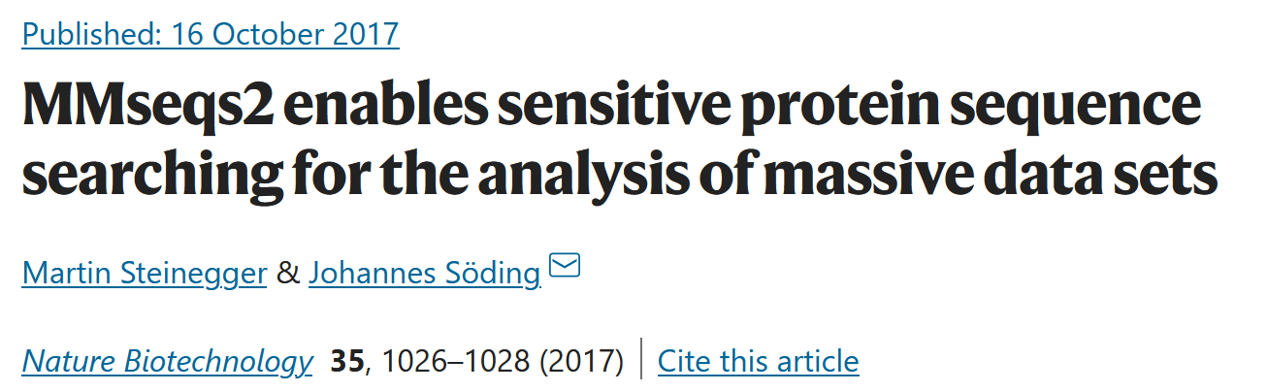
Introduction
Goal
Targeted strategy
Conclusion
And after
Classical approach
Known systems analysis
Targeted strategy : results
→ Targeted strategy – Second step
Targeted strategy – First step
Defense system candidate
TR
715 contigs containing 1814 candidates genes
PFAM x
PFAM y
Prophage
Selection of the best prophages
- Virsorter2
- PHROG and MMSEQ2
- PHASTER
- PHROG and MMSEQ2
MMSEQ
27

Slide 55
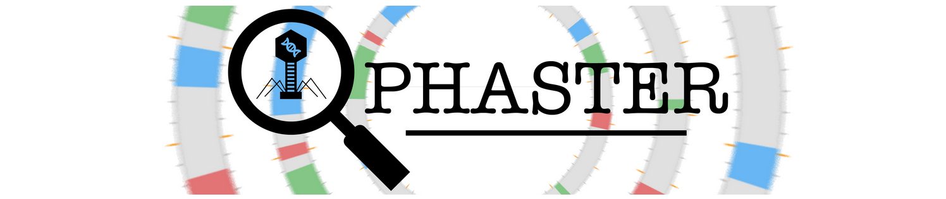
Introduction
Goal
Targeted strategy
Conclusion
And after
Classical approach
Known systems analysis
Targeted strategy : results
→ Targeted strategy – Second step
Targeted strategy – First step
Defense system candidate
TR
715 contigs containing 1814 candidates genes
PFAM x
PFAM y
Prophage
Selection of the best prophages
- Virsorter2
- PHROG and MMSEQ2
- PHASTER
- PHROG and MMSEQ2
28

Slide 56
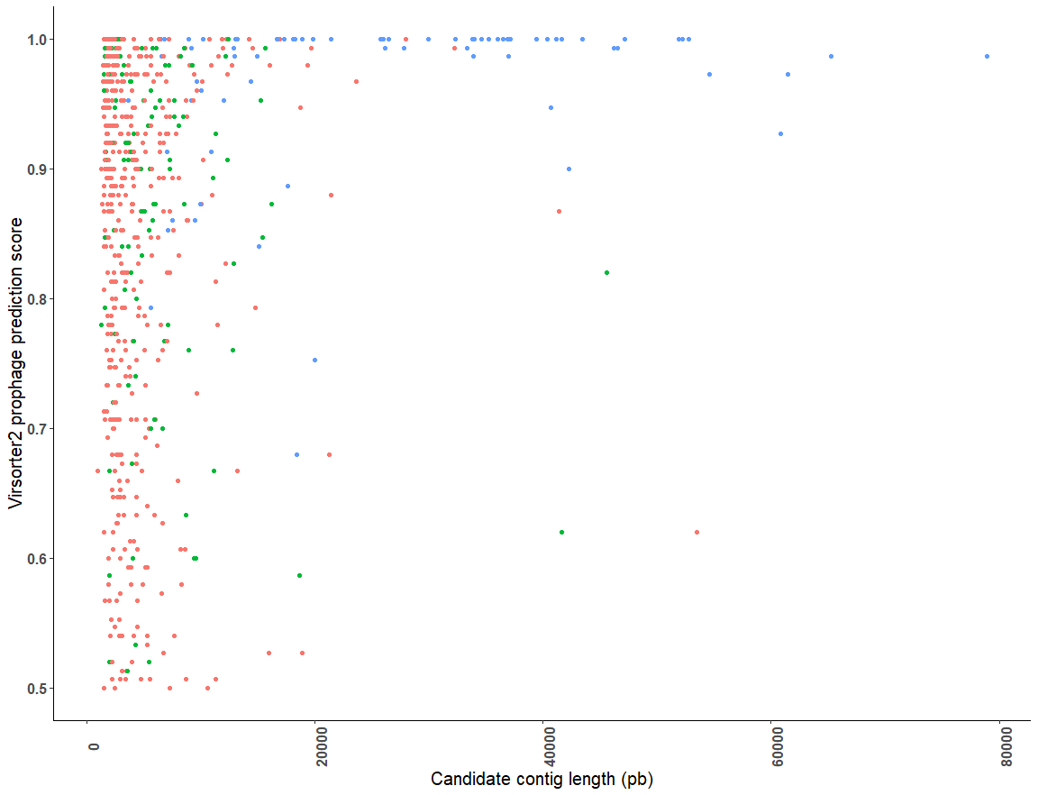
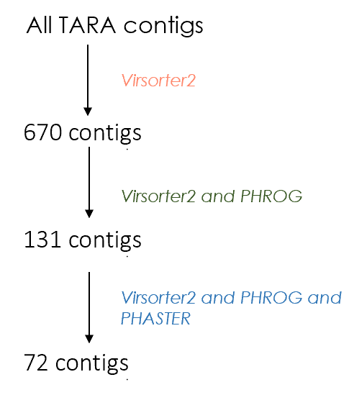
Introduction
Goal
Targeted strategy
Conclusion
And after
Classical approach
Known systems analysis
Targeted strategy : results
→ Targeted strategy – Second step
29

Slide 57
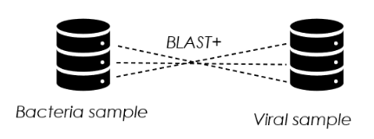

Introduction
Goal
Targeted strategy
Conclusion
And after
Classical approach
Known systems analysis
Targeted strategy : results
→ Targeted strategy – Second step
Defense system candidate
TR
Targeted strategy – First step
715 contigs containing candidates
PFAM x
PFAM y
Prophage
Best prophages selection
72 contigs containing candidates
BLAST bacteria vs viral samples
64 contigs containing candidates
Viral genes in bacterial sample
Viral genes
Bacterial contig
30

Slide 58
Introduction
Goal
Targeted strategy
Conclusion
And after
Classical approach
Known systems analysis
Targeted strategy : results
→ Prophages in TARA
Number of TARA genes | Number of defense genes BLAST & Padloc | Number of defense genes BLAST | Number of defense genes Padloc | Number of prophage genes | Number of prophage genes by Virsorter | Number of prophage genes by PHROG | Number of defends genes in prophages
153.940.861 | 11.297.931 | 1.383.829 | 10.227.402 | 5.562.437 | 3.809.940 | 1.752.497 | 510.388
→ 9.17 % of genes in prophage are defense system genes
31

Slide 59
Introduction
Goal
Targeted strategy
Conclusion
And after
Classical approach
Known systems analysis
Targeted strategy : results
→ Targeted strategy – Candidates ranking
Contig figure
Operon detection
Functionnal annotation of neighbor genes
610 candidates
(610 unknown
expressed genes) in the 64 contigs
Gene order conservation with MMSEQ
Selection of candidates
BLAST vs all TARA sequences
OMRGCV2 abundance
Gene order conservation with FLAGS
Alphafold & DALI
31

Slide 60
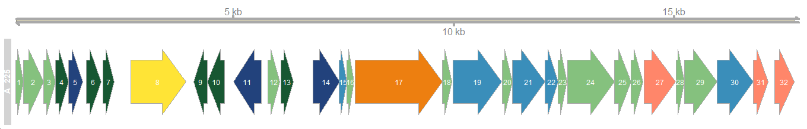
Introduction
Goal
Targeted strategy
Conclusion
And after
Classical approach
Known systems analysis
Targeted strategy : results
→ Targeted strategy – Candidates ranking – contig figures
→ TARA_B100000378_G_scaffold70854_1
Known defence
Known defence expressed
Pfam identified
Pfam identified expressed
Unknown expressed gene
Unknown gene
YR
YR expressed
32

Slide 61

Introduction
Goal
Targeted strategy
Conclusion
And after
Classical approach
Known systems analysis
Targeted strategy : results
→ Targeted strategy – Candidates ranking – Operon detection
→ TARA_B100000378_G_scaffold70854_1 – gene 9 & gene 10
Detection of operon with FGENESB : Bacterial Operon and Gene Prediction tool from SoftBerry
Known defence
Known defence expressed
Pfam identified
Pfam identified expressed
Unknown expressed gene
Unknown gene
YR
YR expressed
candidate | operon_transcription_unit | op_tu_start | op_tu_stop | genes_order
A_225 | 1_op_A_225 | 1 | 2234 | 1_2_3_4_5_6_7
A_225 | 2_tu_A_225 | 2609 | 3862 | 8
A_225 | 3_op_A_225 | 4038 | 4742 | 9_10
A_225 | 4_tu_A_225 | 4935 | 5570 | 11
A_225 | 5_op_A_225 | 5723 | 17068 | 12_13_14_15_16_17_18_19_20_21_22_23_24_25_26_27_28_29_30_31
A_225 | 6_tu_A_225 | 17212 | 17647 | 32
32

Slide 62
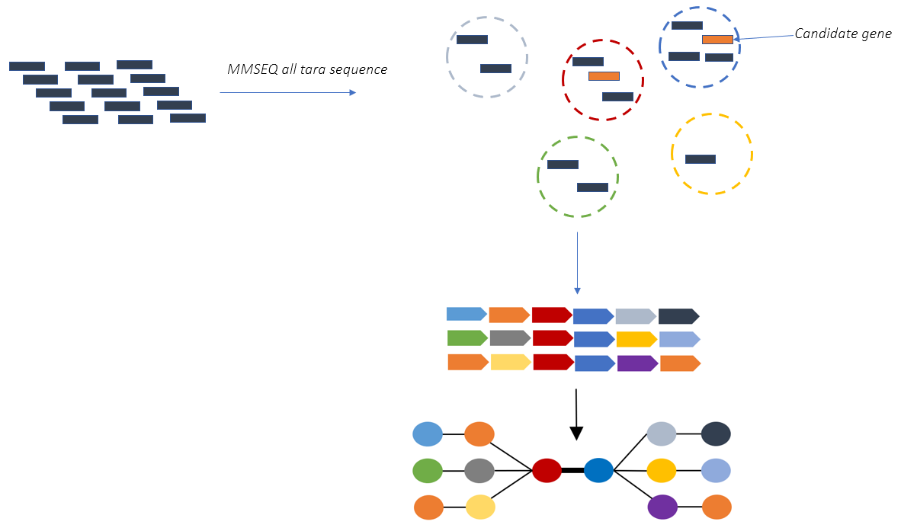
Introduction
Goal
Targeted strategy
Conclusion
And after
Classical approach
Known systems analysis
Targeted strategy : results
→ Targeted strategy – Candidates ranking – Gene order conservation with MMSEQ
1 - MMSEQ of all TARA sequences
2 - extraction of all cluster containing a candidate genes
3 – computation of a network with gene conservation order. The size of vertex is proportional to the number of other contigs with the same conservation of gene order. 2 type of network (conservation by 2 genes and by modules see example after)
32

Slide 63
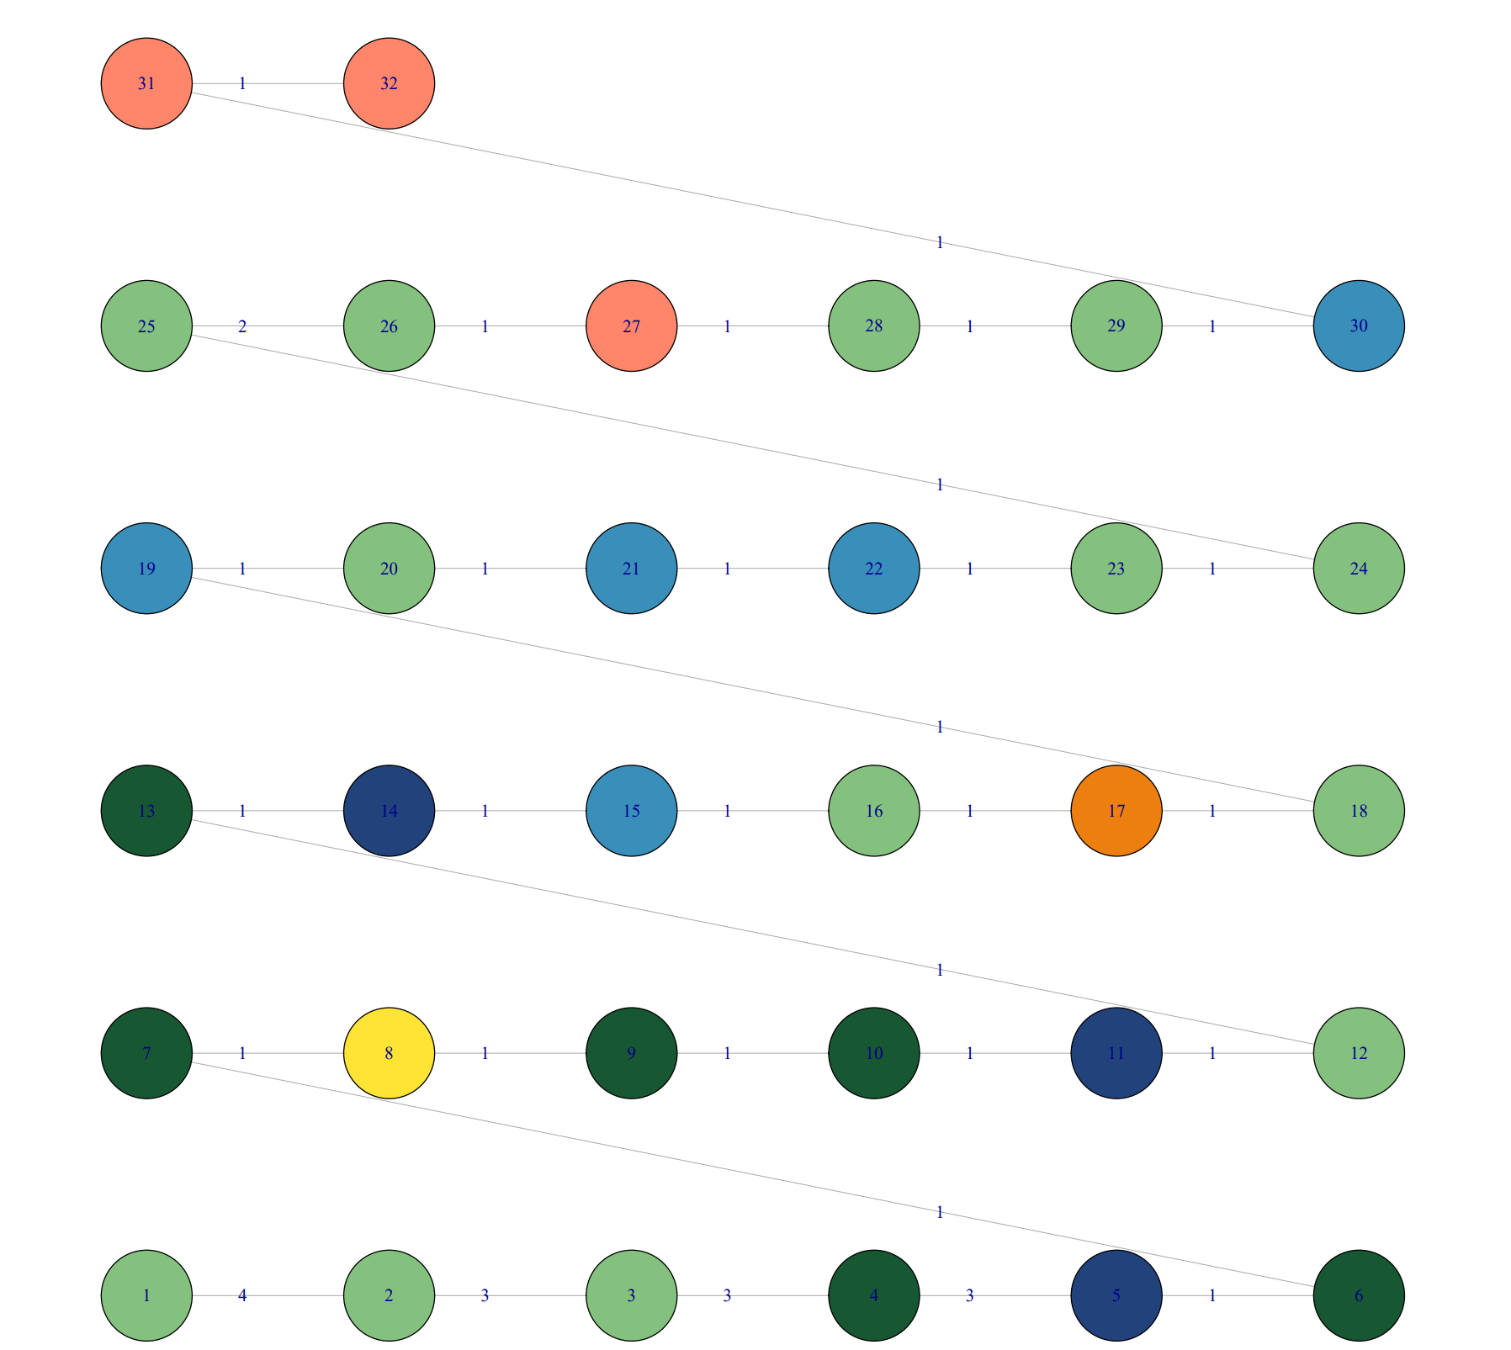
Introduction
Goal
Targeted strategy
Conclusion
And after
Classical approach
Known systems analysis
Targeted strategy : results
→ Targeted strategy – Candidates ranking – Gene order conservation with MMSEQ
→ According to MMSEQ Gene 9 and 10 are finding together in 1 bacterial contigs
- too restrictive MMSEQ threshold?
32

Slide 64

Introduction
Goal
Targeted strategy
Conclusion
And after
Classical approach
Known systems analysis
Targeted strategy : results
→ Targeted strategy – Candidates ranking – BLAST vs all TARA sequences
Candidate genes
9
10
BLAST+
Extraction of all
Contigs with these similar genes
TARA database
Extraction of all
Simalar genes
Gene 11
Gene 10
Gene 9
Gene 8
Gene 8
Gene 9
Gene 10
Gene 11
Heatmap for gene order conservation with similar genes
32

Slide 65
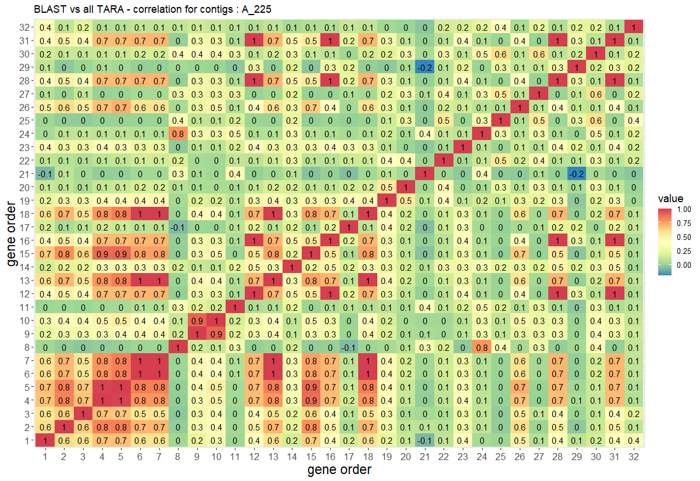
Introduction
Goal
Targeted strategy
Conclusion
And after
Classical approach
Known systems analysis
Targeted strategy : results
→ Targeted strategy – Candidates ranking – BLAST vs all TARA sequences
32

Slide 66
Introduction
Goal
Targeted strategy
Conclusion
And after
Classical approach
Known systems analysis
Targeted strategy : results
→ Targeted strategy – Candidates ranking – BLAST vs all TARA sequences
32

Slide 67
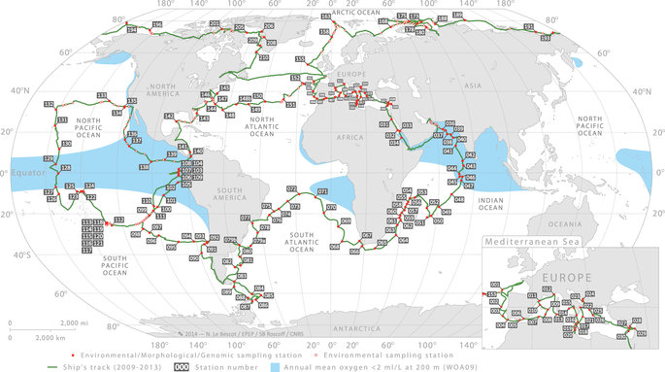
Introduction
Goal
Targeted strategy
Conclusion
And after
Classical approach
Known systems analysis
Targeted strategy : results
→ Targeted strategy – Candidates ranking – OMRGC_V2 abundance
Candidate genes
 | Sample1 | Sample 2 | Sample 3 | Sample 4
Gene 8 | 1 | 8 | 0 | 0
Gene 9 | 5 | 0 | 0 | 9
Gene 10 | 6 | 0 | 0 | 9
Gene 11 | 1 | 1 | 9 | 0
9
10
All genes in candidate contigs
Extraction of abundance of similar genes in other samples
Gene 11
Gene 10
Gene 9
Gene 8
Gene 8
Gene 9
Gene 10
Gene 11
Heatmap for gene order conservation with abundance in other sampler
32

Slide 68
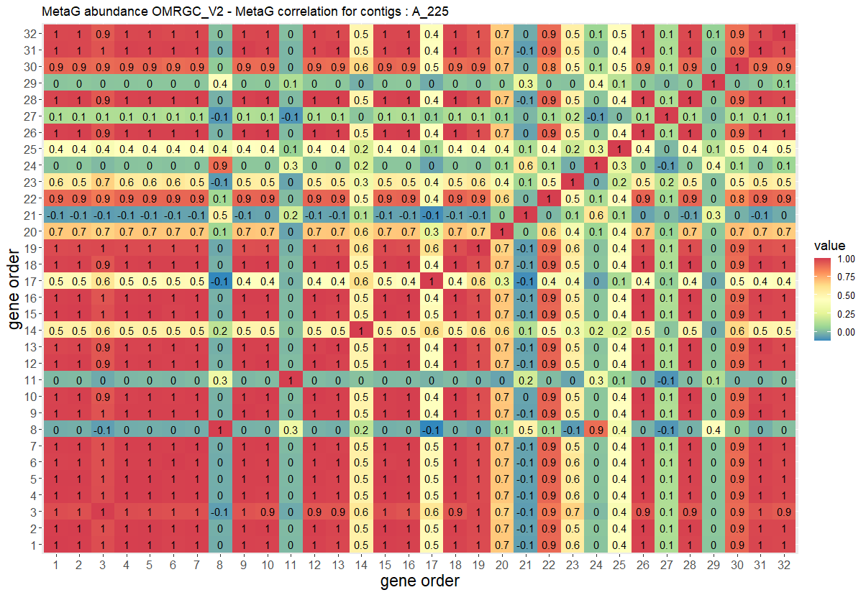
Introduction
Goal
Targeted strategy
Conclusion
And after
Classical approach
Known systems analysis
Targeted strategy : results
→ Targeted strategy – Candidates ranking – OMRGC_V2 abundance
32

Slide 69
Introduction
Goal
Targeted strategy
Conclusion
And after
Classical approach
Known systems analysis
Targeted strategy : results
→ Targeted strategy – Candidates ranking – OMRGC_V2 abundance
32

Slide 70
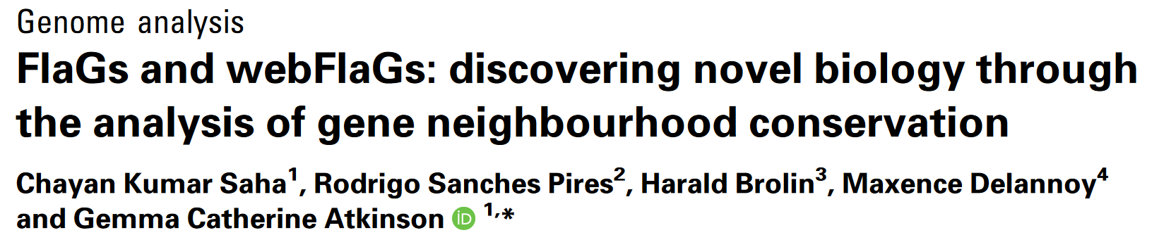
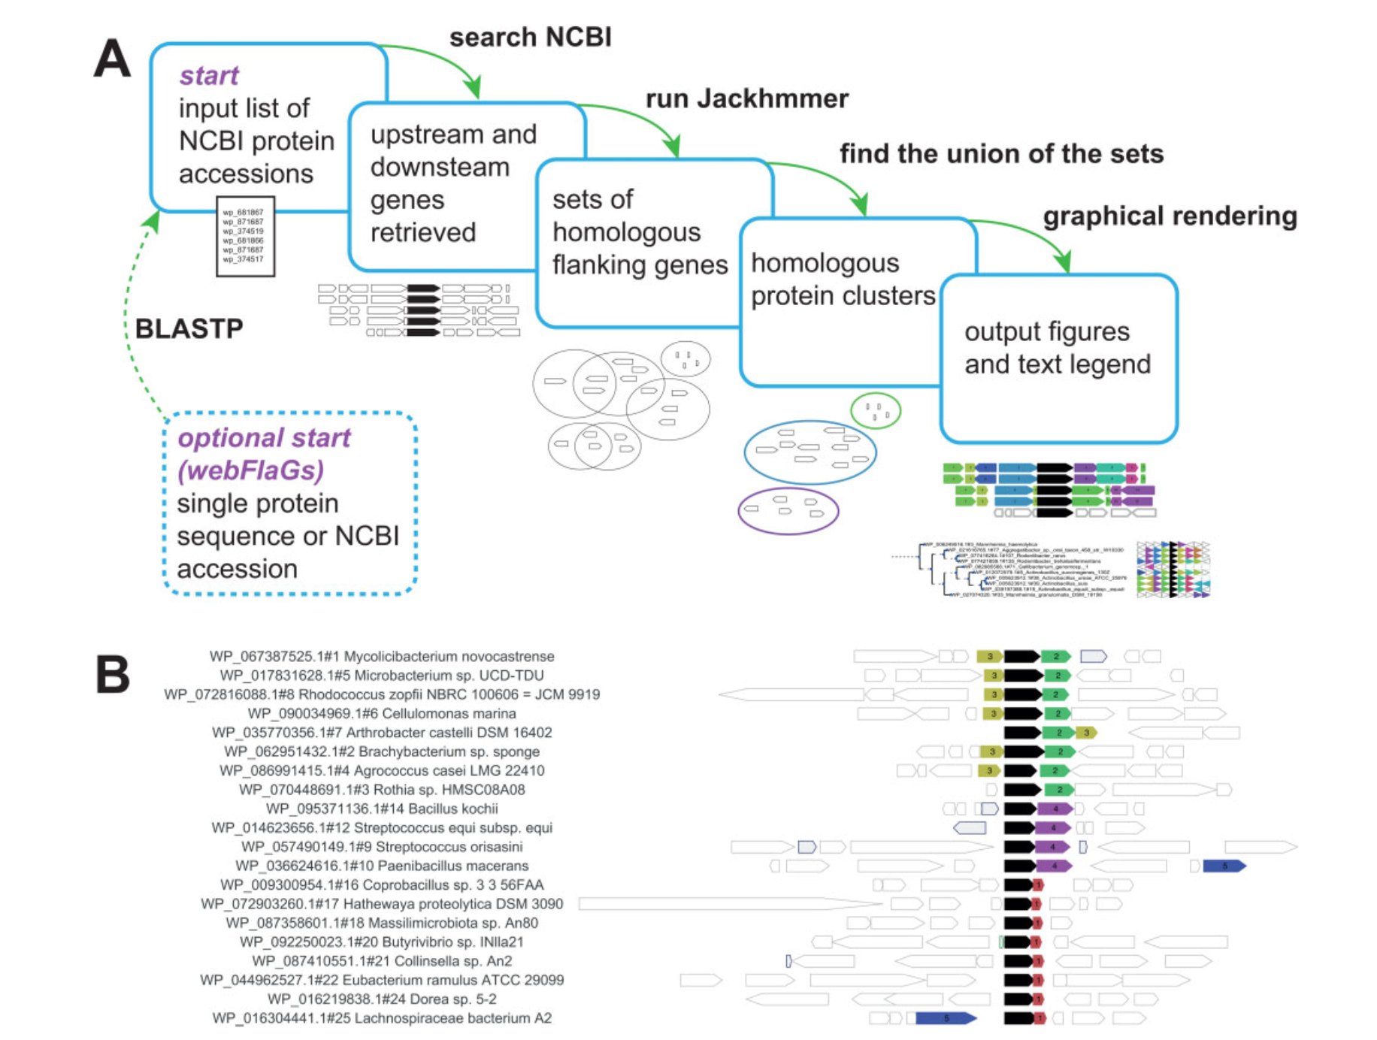
Introduction
Goal
Targeted strategy
Conclusion
And after
Classical approach
Known systems analysis
Targeted strategy : results
→ Targeted strategy – Candidates ranking – FLAGS gene order conservation
32

Slide 71
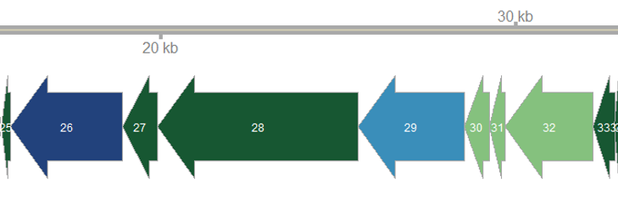
Introduction
Goal
Targeted strategy
Conclusion
And after
Classical approach
Known systems analysis
Targeted strategy : results
→ Targeted strategy – Candidates ranking – FLAGS gene order conservation
Example of a FLAGS result
FLAG results example
Gene 28
Org A
Gene 28
Org B
Gene 28
Org C
Gene 28
Org A
Org A
Gene 27
Gene 27
Org A
Gene 27
Org X
Gene 27
Org Z
32

Slide 72
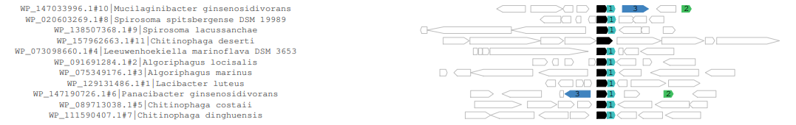

Introduction
Goal
Targeted strategy
Conclusion
And after
Classical approach
Known systems analysis
Targeted strategy : results
→ Targeted strategy – Candidates ranking – FLAGS gene order conservation
1 - hypothetical protein
2 - single-stranded DNA-binding protein
3 - IS1595 family transposase
1 - hypothetical protein
2 - single-stranded DNA-binding protein
3 - IS1595 family transposase
32

Slide 73






Introduction
Goal
Targeted strategy
Conclusion
And after
Classical approach
Known systems analysis
Targeted strategy : results
→ Targeted strategy – Candidates ranking – AlphaFold / DALI
10
9
10
9

Slide 74
Introduction
Goal
Targeted strategy
Conclusion
And after
Classical approach
Known systems analysis
Targeted strategy : results
→ Targeted strategy – Summary
- TARA data
Defense system candidate
- Virsorter2
TR
715 contigs
metaT data
PFAM x
PFAM y
Prophage
YR HMMsearch
47

Slide 75
Introduction
Goal
Targeted strategy
Conclusion
And after
Classical approach
Known systems analysis
Targeted strategy : results
→ Targeted strategy – Summary
- TARA data
Defense system candidate
- Virsorter2
TR
715 contigs
metaT data
PFAM x
PFAM y
Prophage
YR HMMsearch
PHASTER
PHROGS
BLAST Bacteria vs Virus
64 contigs
47

Slide 76
Introduction
Goal
Targeted strategy
Conclusion
And after
Classical approach
Known systems analysis
Targeted strategy : results
→ Targeted strategy – Summary
- TARA data
Defense system candidate
- Virsorter2
TR
715 contigs
metaT data
PFAM x
PFAM y
Prophage
YR HMMsearch
PHASTER
PHROGS
BLAST Bacteria vs Virus
64 contigs
Ranking of candidates (FLAGS, Alphafold, Heatmap,…)
And after…?
47

Slide 77
Introduction
Goal
Targeted strategy
Conclusion
And after
Classical approach
Known systems analysis
Targeted strategy : results
→ Targeted strategy – Summary
- TARA data
Defense system candidate
- Virsorter2
TR
715 contigs
metaT data
PFAM x
PFAM y
Prophage
YR HMMsearch
PHASTER
PHROGS
BLAST Bacteria vs Virus
64 contigs
Ranking of candidates (FLAGS, Alphafold, Heatmap,…)
Experimental validation of current selected genes
Selection of other candidates
Untargetted strategy
Creation of the “global tool”
47

Slide 78
Introduction
Goal
Targeted strategy
Conclusion
And after
Classical approach
Known systems analysis
Targeted strategy : results
→ Targeted strategy – Candidates ranking – BLAST vs all TARA sequences

Slide 79

→ Experimental validation of candidates
Collaboration with the MiMS laboratory of Vasili Hauryliuk from Lund university
48

Slide 80

→ Test Killing/Rescue

Slide 81
Introduction
Goal
Targeted strategy
Conclusion
And after
Classical approach
Known systems analysis
Targeted strategy : results
→ Global tool

Slide 82

Thank you for your attention

Slide 83

→ Transfert horizontal

Slide 84


→ Stratégie non-ciblée : génomique comparative
TARA Oceans
86 M contigs (154 M gènes)
Filtration des contigs >3 gènes
11 M contigs (52 M gènes)
MMseq2 clustering des
34 M gènes bactériens & 18 M gènes viraux

Slide 85

→ Système de défense connus chez TARA – comparaison des fractions bactériennes et virales
 |  | Bacterial sample |  |  |  | Viral sample
Defence system | Number of sequences in the database | Number of contigs detected | Number of genes detected | Number of contig with expressed genes | Number of expressed genes | Number of contigs detected | Number of genes detected | Number of contig with expressed genes | Number of expressed genes
ABI | 71.504 | 7349 | 7486 | 2178 | 2212 | 7517 | 7943 | 1053 | 1103
BREX | 475.400 | 87.673 | 91.332 | 30.432 | 31.364 | 49.306 | 53.375 | 7.999 | 8.457
CRISPR | 154.181 | 6410 | 7862 | 2115 | 2368 | 2362 | 3942 | 401 | 561
DISARM | 420.961 | 193432 | 196896 | 59054 | 60080 | 81055 | 85552 | 13740 | 14321
DND | 101.016 | 44.812 | 46.028 | 13.252 | 13.526 | 17.118 | 18.096 | 2801 | 2909
DRUANTIA | 734.683 | 239945 | 243034 | 67706 | 68573 | 76549 | 79716 | 12662 | 13023
GABIJA | 324.353 | 26.519 | 27.531 | 9124 | 9354 | 11.240 | 12.629 | 2203 | 2388
HACHIMAN | 723.485 | 223490 | 225686 | 61698 | 62263 | 57868 | 60472 | 9795 | 10090
KIWA | 4386 | 3069 | 3151 | 821 | 830 | 207 | 283 | 43 | 49
LAMASSU | 129.792 | 13.794 | 13.835 | 4919 | 4937 | 4031 | 4082 | 804 | 810
PAGOS | 1629 | 212 | 216 | 36 | 36 | 466 | 506 | 70 | 74
RM | 1.029.841 | 421912 | 444627 | 126881 | 132650 | 176473 | 201220 | 25702 | 28372
SEPTU | 152.696 | 99.373 | 100.409 | 27.102 | 27.348 | 29.408 | 31.049 | 4428 | 4555
SHEDU | 2674 | 189 | 189 | 38 | 38 | 236 | 236 | 32 | 32
TA | 1.236.425 | 137601 | 155344 | 35523 | 38290 | 84876 | 115555 | 11456 | 13526
THOERIS | 45.719 | 3700 | 3879 | 1243 | 1282 | 3758 | 4098 | 520 | 546
WADJET | 101.215 | 30.850 | 31.390 | 8021 | 8121 | 5916 | 6602 | 1060 | 1115
ZORYA | 880.586 | 289319 | 301298 | 85545 | 88072 | 94299 | 103160 | 15314 | 16205
TOTAL | 6.590.546 | 1829649 | 1900193 | 535688 | 551344 | 702685 | 788516 | 110083 | 118136

Slide 86




→ Représentation en réseau

Slide 87



Stratégies des phages pour contrecarrer les systèmes de défense
Sungwon Hwang and Karen L. Maxwell « Meet the Anti-CRISPRs : Widespread Protein Inhibitors of CRISPR-Cas Systems » The CRISPR Journal 2019

Slide 88
→ Targeted strategy – Candidates ranking – Annotation of genes in figure
→ TARA_B100000378_G_scaffold70854_1 – gene 9 & gene 10
PF03837
RecT
PF12706
Lactamase_B_2
Known defence
RM
Tyrosine recombinase
PF00589
Integrase
Known defence
Septu
PF12728
HTH_17
PF13248
Zf_ribbon_3
Known defence
PF08346
Ant_A
PF01695
IstB_IS21
PF08279
HTH_11
PF12728 – HTH_17
PF13413
HTH_24

Slide 89

→ Targeted strategy – Candidates ranking – other mmseq

Slide 90

→ Targeted strategy – Candidates ranking – abundance by sample

Slide 91


Slide 92

The padloc HMM file
The padloc hmm file used contains:
42 differents defense system and 2975 hmm.name
Difference with my database :
- more defense systems
- in PADLOC missing RM
- TA are include in Abi

Slide 93
My known defense database
My known defense database contains sequence for 18 defence systems.
Each system is divided into sub-system each one
constituting by sub-units which are genes
constituting the system (see annex for the sub-units).
And my database is composed of one sequences by
sub-units.
Defence system | Number of protein in the database
ABI | 71.504
BREX | 475.400
CRISPR | 154.181
DISARM | 420.961
DND | 101.016
DRUANTIA | 734.683
GABIJA | 324.353
HACHIMAN | 723.485
KIWA | 4836
LAMASSU | 129.792
PAGOS | 1629
RM | 1.029.841
SEPTU | 152.696
SHEDU | 2674
TA | 1.236.425
THOERIS | 45.719
WADJET | 101.215
ZORYA | 880.586
Number of defence systems | 18
Number of distinct instances (product accession) | 4.989.722
Number of distinct organisms (taxa id) | 36.435
Number of distinct metagenomes | 523
Number of distinct protein sequences | 4.989.722
Number of distinct DNA sequences | 4.989.722
Number of distinct variables for all the library | 37

Slide 94
My known defense database
→ Literature :
Doron, S., & Sorek, R. (2017). Systematic discovery of antiphage defense systems in the microbial pangenome. Nature Microbiology, 359, 1–9. https://doi.org/10.1038/s41564-017-0051-0
Goldfarb, T., Sberro, H., Weinstock, E., Cohen, O., Doron, S., Charpak-amikam, Y., Afik, S., Ofir, G., & Sorek, R. (2014). BREX is a novel phage resistance system widespread in microbial genomes. The EMBO Journal, 1–16.
Makarova, K. S., Anantharaman, V., Grishin, N. V, Koonin, E. V, & Aravind, L. (2014). CARF and WYL domains : ligand-binding regulators of prokaryotic defense systems. Original Research Article, 5(April), 1–9. https://doi.org/10.3389/fgene.2014.00102
Makarova, K. S., Haft, D. H., Barrangou, R., Brouns, S. J. J., Mojica, F. J. M., Wolf, Y. I., Yakunin, A. F., Oost, J. Van Der, & Koonin, E. V. (2011). Evolution and classification of the CRISPR–Cas systems. Nature Publishing Group, 9(6), 467–477. https://doi.org/10.1038/nrmicro2577
Makarova, K. S., Wolf, Y. I., Oost, J. Van Der, & Koonin, E. V. (2009). Prokaryotic homologs of Argonaute proteins are predicted to function as key components of a novel system of defense against mobile genetic elements. BioMed Central, 15, 1–15. https://doi.org/10.1186/1745-6150-4-29
Makarova, K. S., Wolf, Y. I., Snir, S., & Koonin, E. V. (2011). Defense Islands in Bacterial and Archaeal Genomes and Prediction of Novel Defense Systems. Journal, 193(21), 6039–6056.
Ofir, G., Melamed, S., Sberro, H., Doron, S., & Sorek, R. (2017). DISARM is a widespread bacterial defence system with broad anti-phage activities. Nature Microbiology. https://doi.org/https://doi.org/10.1038/s41564-017-0051-0
→ Database:
El-gebali, S., Mistry, J., Bateman, A., Eddy, S. R., Potter, S. C., Qureshi, M., Richardson, L. J., Salazar, G. A., Smart, A., Sonnhammer, E. L. L., Hirsh, L., Paladin, L., Piovesan, D., Tosatto, S. C. E., & Finn, R. D. (2019). The Pfam protein families database in 2019. Nucleic Acids Research, 8, 1–6. https://doi.org/10.1093/nar/gky995
Galperin, M. Y., Makarova, K. S., Wolf, Y. I., & Koonin, E. V. (2015). Expanded microbial genome coverage and improved protein family annotation in the COG database. Nucleic Acids Research, 43(November 2014), 6–7. https://doi.org/10.1093/nar/gku1223
Haft, D. H., Loftus, B. J., Richardson, D. L., Yang, F., Eisen, J. A., Paulsen, I. T., & White, O. (2001). TIGRFAMs: a protein family resource for the functional identification of proteins. Nuc, 29, 41–43.
Roberts, R. J., Vincze, T., Posfai, J., & Macelis, D. (2015). REBASE–a database for DNA restriction and modification: enzymes, genes and genomes. Nucleic Acids Research, 43(298–299).
Sayers, E. W., Agarwala, R., Bolton, E. E., Brister, J. R., Canese, K., Clark, K., Connor, R., Fiorini, N., Funk, K., & Hefferon, T. (2019). Database resources of the National Center for Biotechnology Information. Nucleic Acids Research, 47(23–28).
Xie, Y., Wei, Y., Shen, Y., Li, X., Zhou, H., Tai, C., Deng, Z., & Ou, H. Y. (2018). ADB 2.0: an updated database of bacterial type II toxin-antitoxin loci. Nucleic Acids Research, 46(749–753).
Zhang, Y., Zhang, Z., Zhang, H., Zhao, Y., Zhang, Z., & Xiao, J. (2020). PADS Arsenal : a database of prokaryotic defense systems related genes. Nucleic Acids Research, 48(October 2019), 590–598. https://doi.org/10.1093/nar/gkz916

Slide 95

Nombre de systèmes de défense | 18
Nombre total d’instances | 6 515 586
Nombre d’instances distinctes | 4 989 722
Nombre d’organismes distincts | 36 435
Littérature - sources | Doron, S., & Sorek, R. (2017). Goldfarb, T., Sberro, H., Weinstock, E., Cohen, O., Doron, S., Charpak-amikam, Y., Afik, S., Ofir, G., & Sorek, R. (2014). Makarova, K. S., Anantharaman, V., Grishin, N. V, Koonin, E. V, & Aravind, L. (2014). Makarova, K. S., Haft, D. H., Barrangou, R., Brouns, S. J. J., Mojica, F. J. M., Wolf, Y. I., Yakunin, A. F., Oost, J. Van Der, & Koonin, E. V. (2011 Makarova, K. S., Wolf, Y. I., Oost, J. Van Der, & Koonin, E. V. (2009). Makarova, K. S., Wolf, Y. I., Snir, S., & Koonin, E. V. (2011). Ofir, G., Melamed, S., Sberro, H., Doron, S., & Sorek, R. (2017).
Base de données - sources | El-gebali, S., Mistry, J., Bateman, A., Eddy, S. R., Potter, S. C., Qureshi, M., Richardson, L. J., Salazar, G. A., Smart, A., Sonnhammer, E. L. L., Hirsh, L., Paladin, L., Piovesan, D., Tosatto, S. C. E., & Finn, R. D. (2019). Galperin, M. Y., Makarova, K. S., Wolf, Y. I., & Koonin, E. V. (2015). Haft, D. H., Loftus, B. J., Richardson, D. L., Yang, F., Eisen, J. A., Paulsen, I. T., & White, O. (2001). Roberts, R. J., Vincze, T., Posfai, J., & Macelis, D. (2015). Sayers, E. W., Agarwala, R., Bolton, E. E., Brister, J. R., Canese, K., Clark, K., Connor, R., Fiorini, N., Funk, K., & Hefferon, T. (2019). Xie, Y., Wei, Y., Shen, Y., Li, X., Zhou, H., Tai, C., Deng, Z., & Ou, H. Y. (2018). Zhang, Y., Zhang, Z., Zhang, H., Zhao, Y., Zhang, Z., & Xiao, J. (2020).

Slide 96




Bactérie
Archée
Systèmes de défense
Domaine
Nombre de « product accession »
Systèmes de défense

Slide 97



Slide 98


Slide 99


Slide 100


Slide 101


